Slide 1
 | Age (yrs) | Gender | Education (yrs) | MoCA
Younger Adults (n=31) | 23.65 (2.86) | 54.80% female (n=17) | 15.90 (2.27) | N/A
Older Adults (n=27) | 73.44 (7.06) | 51.90% female (n=14) | 15.30 (3.69) | 28.11 (1.01)
Data from first 8 blocks used consistently across block and trial-level analyses.

Slide 2
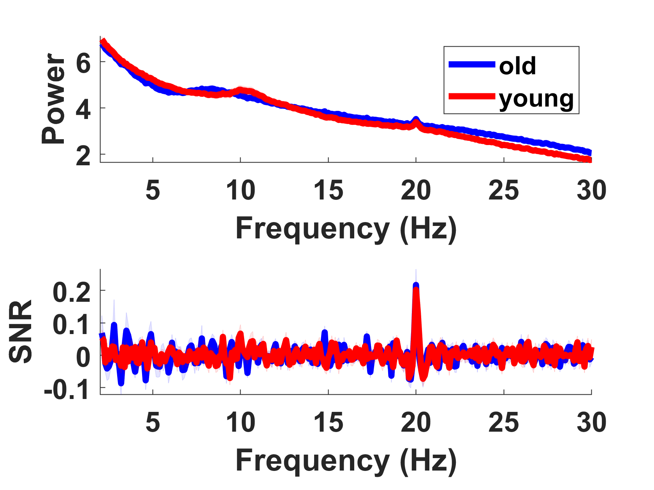
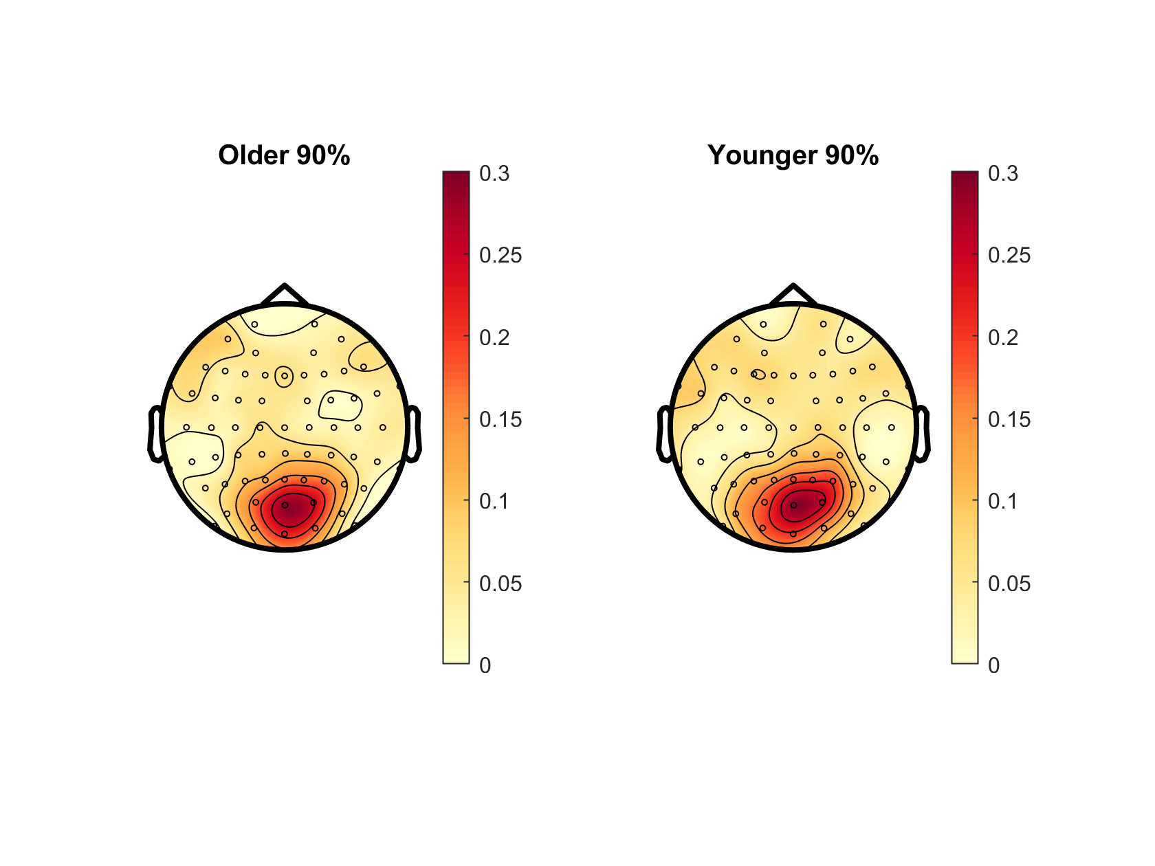
Notes:
? Slightly different to Oz PSD in plotPowerSpec script

Slide 3
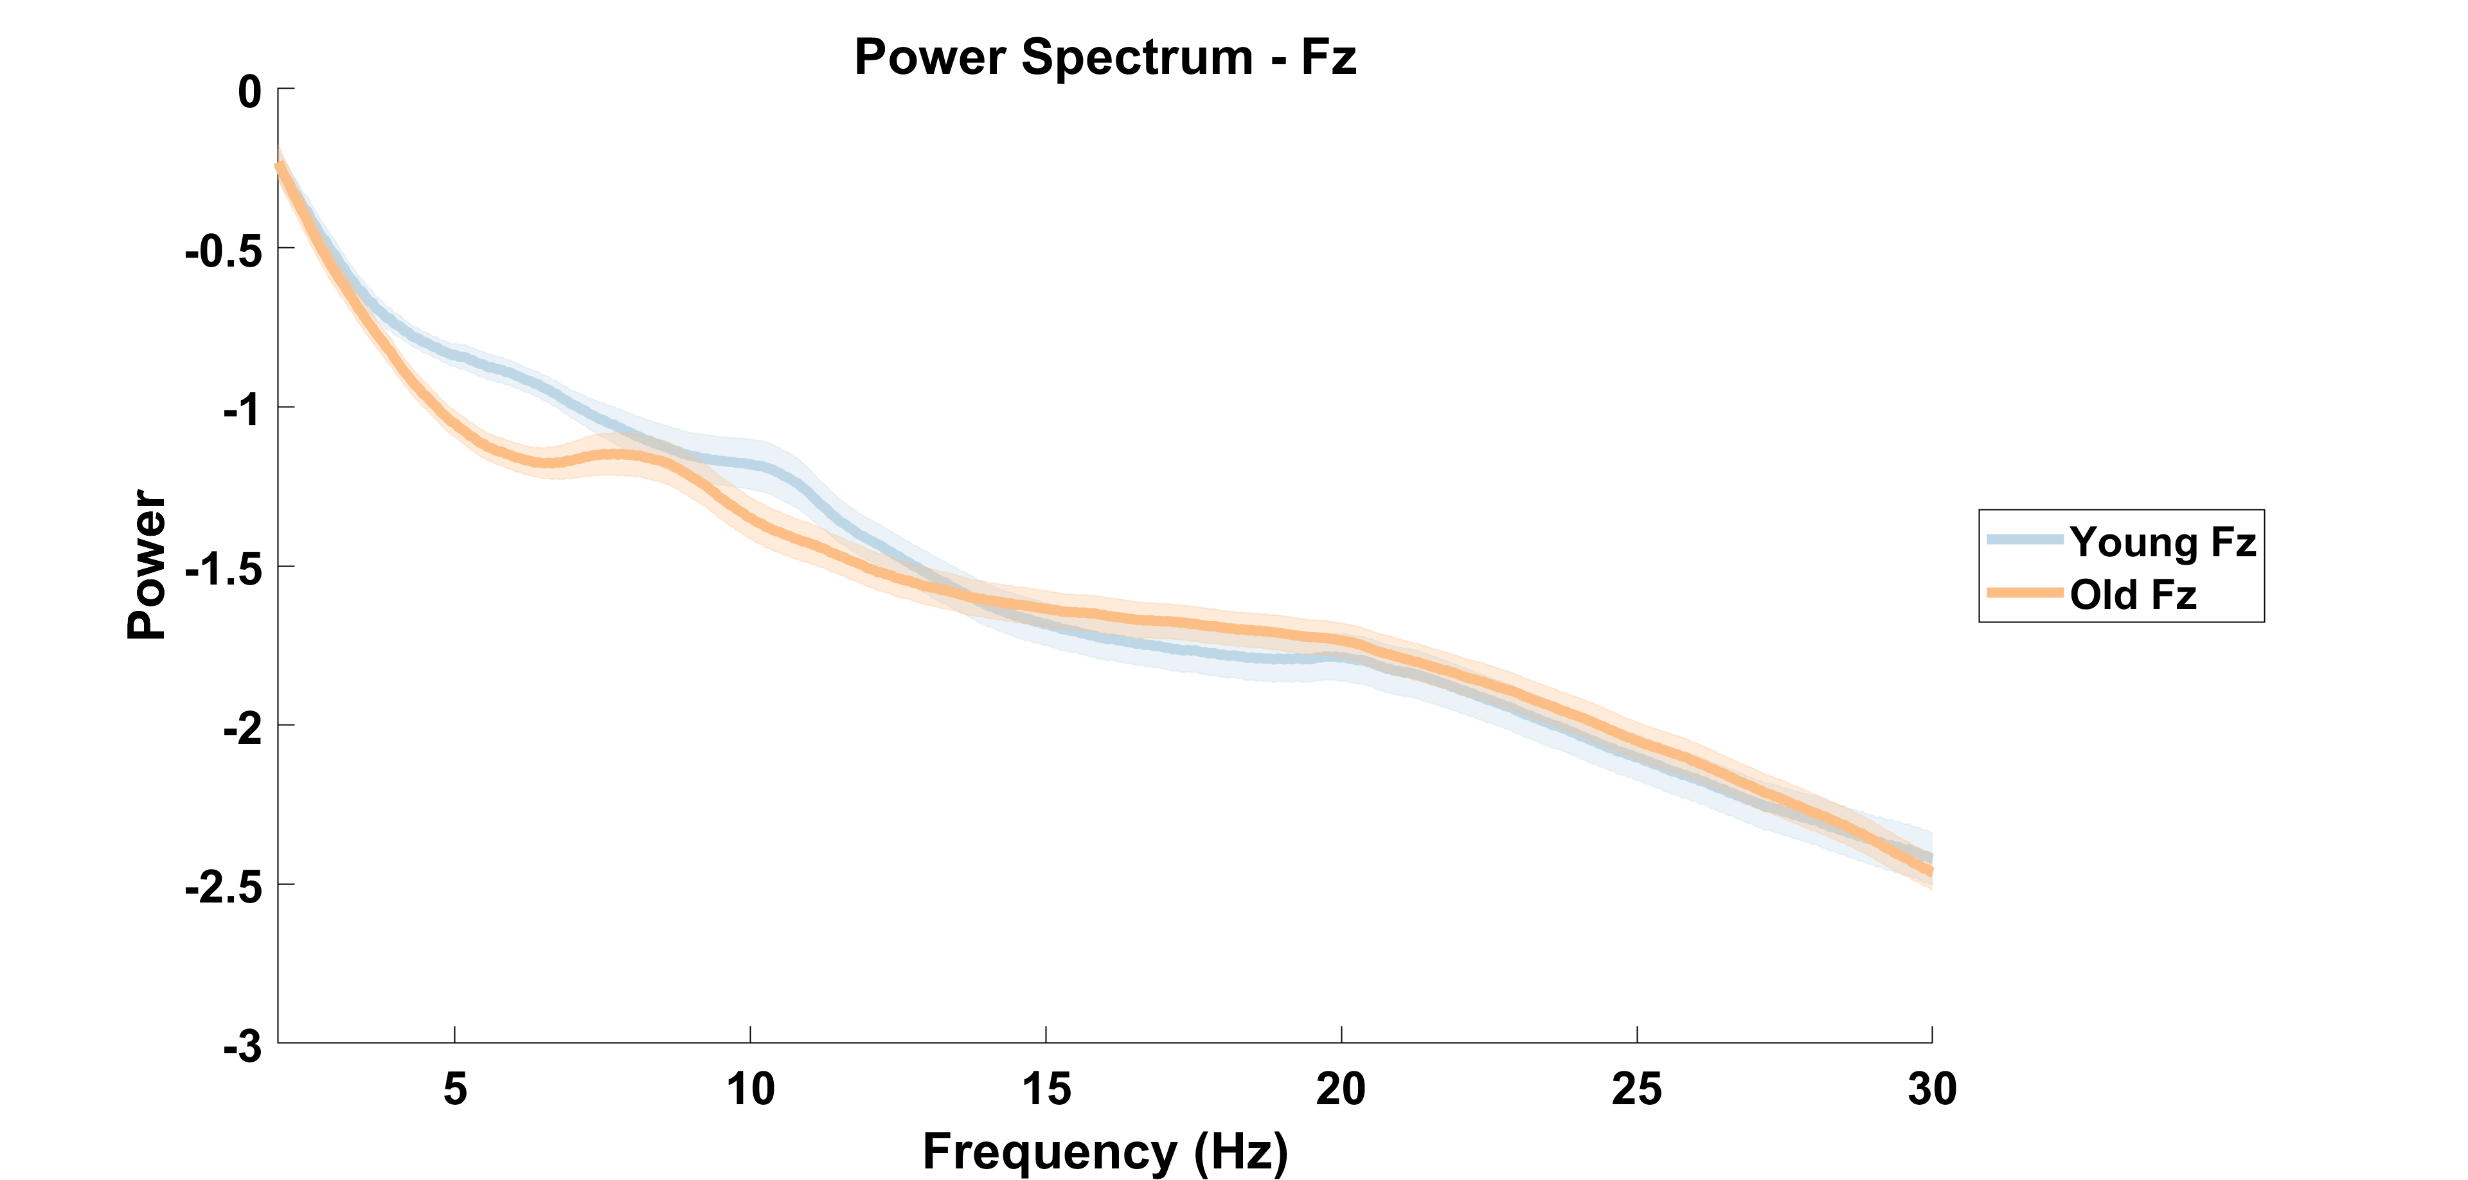

Slide 4
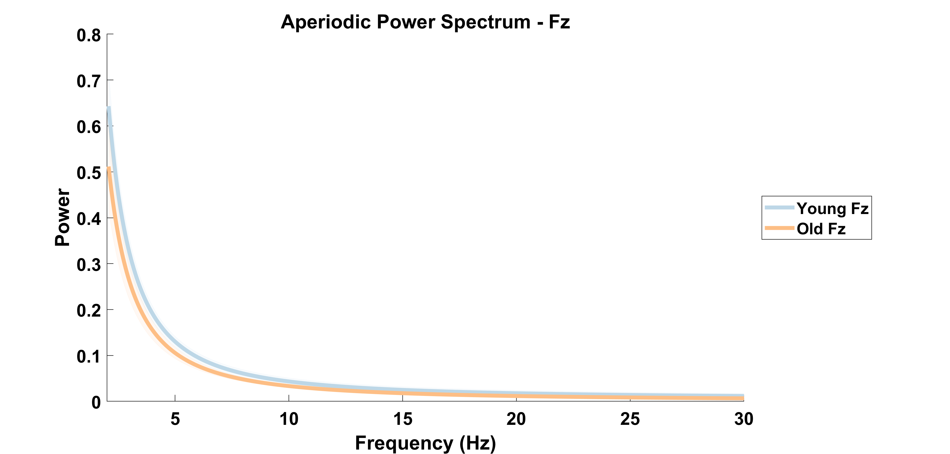

Slide 5
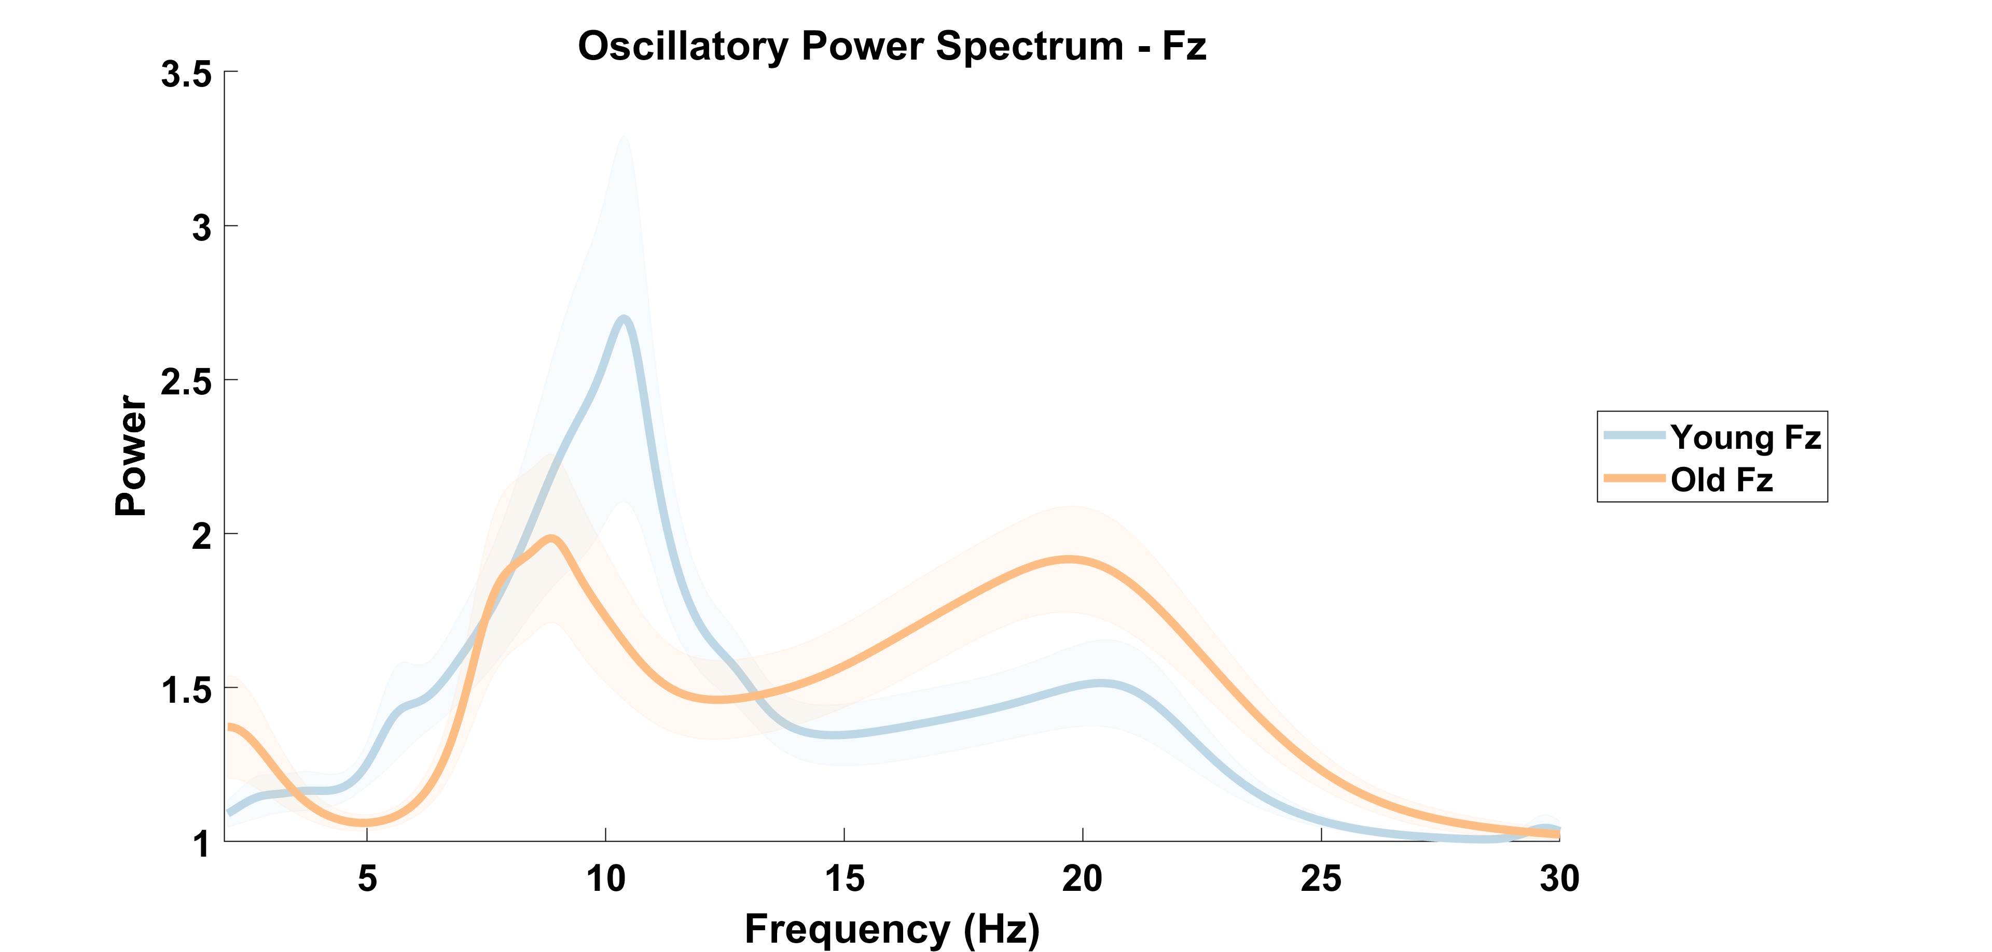

Slide 6
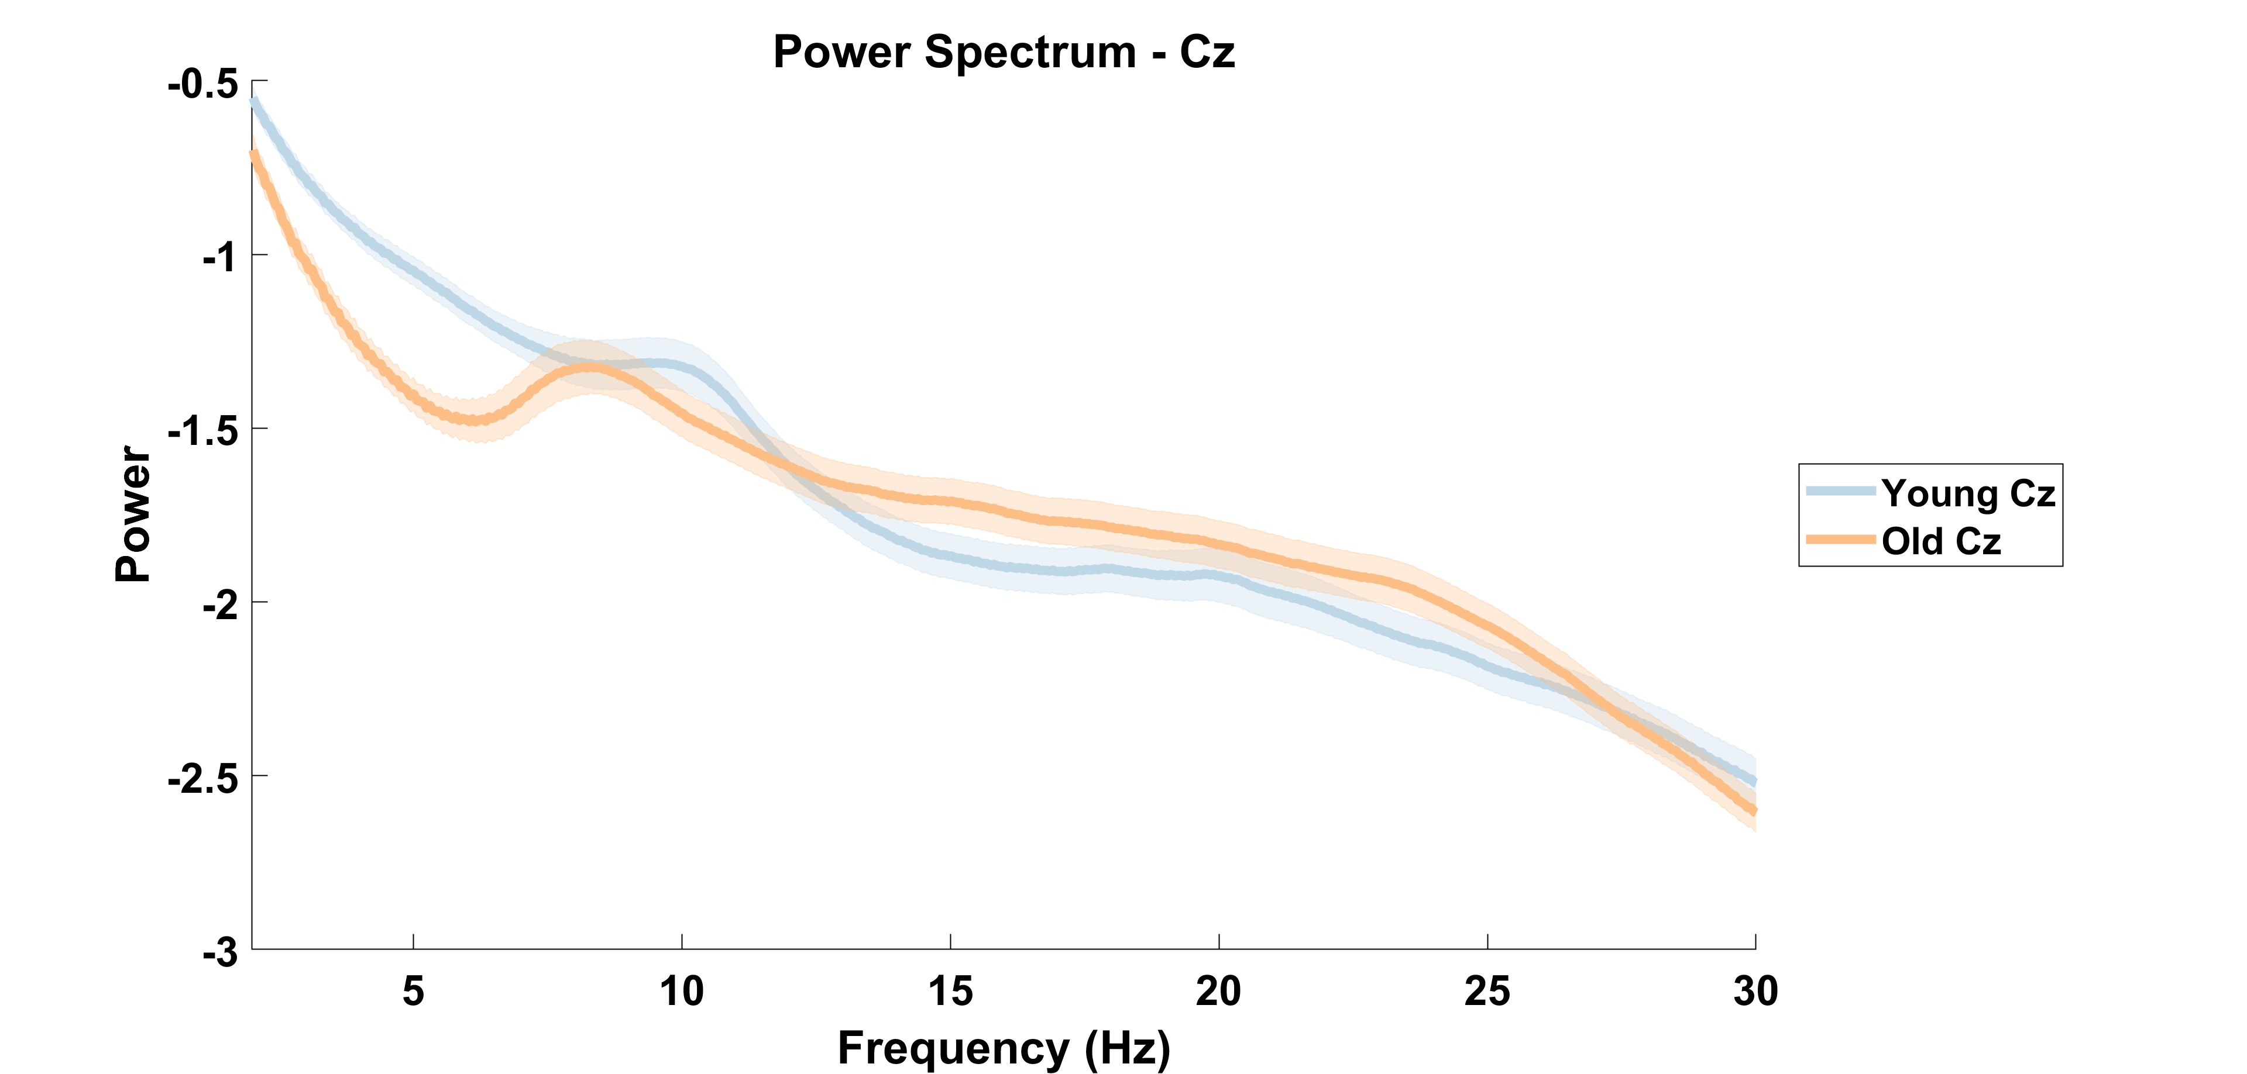

Slide 7
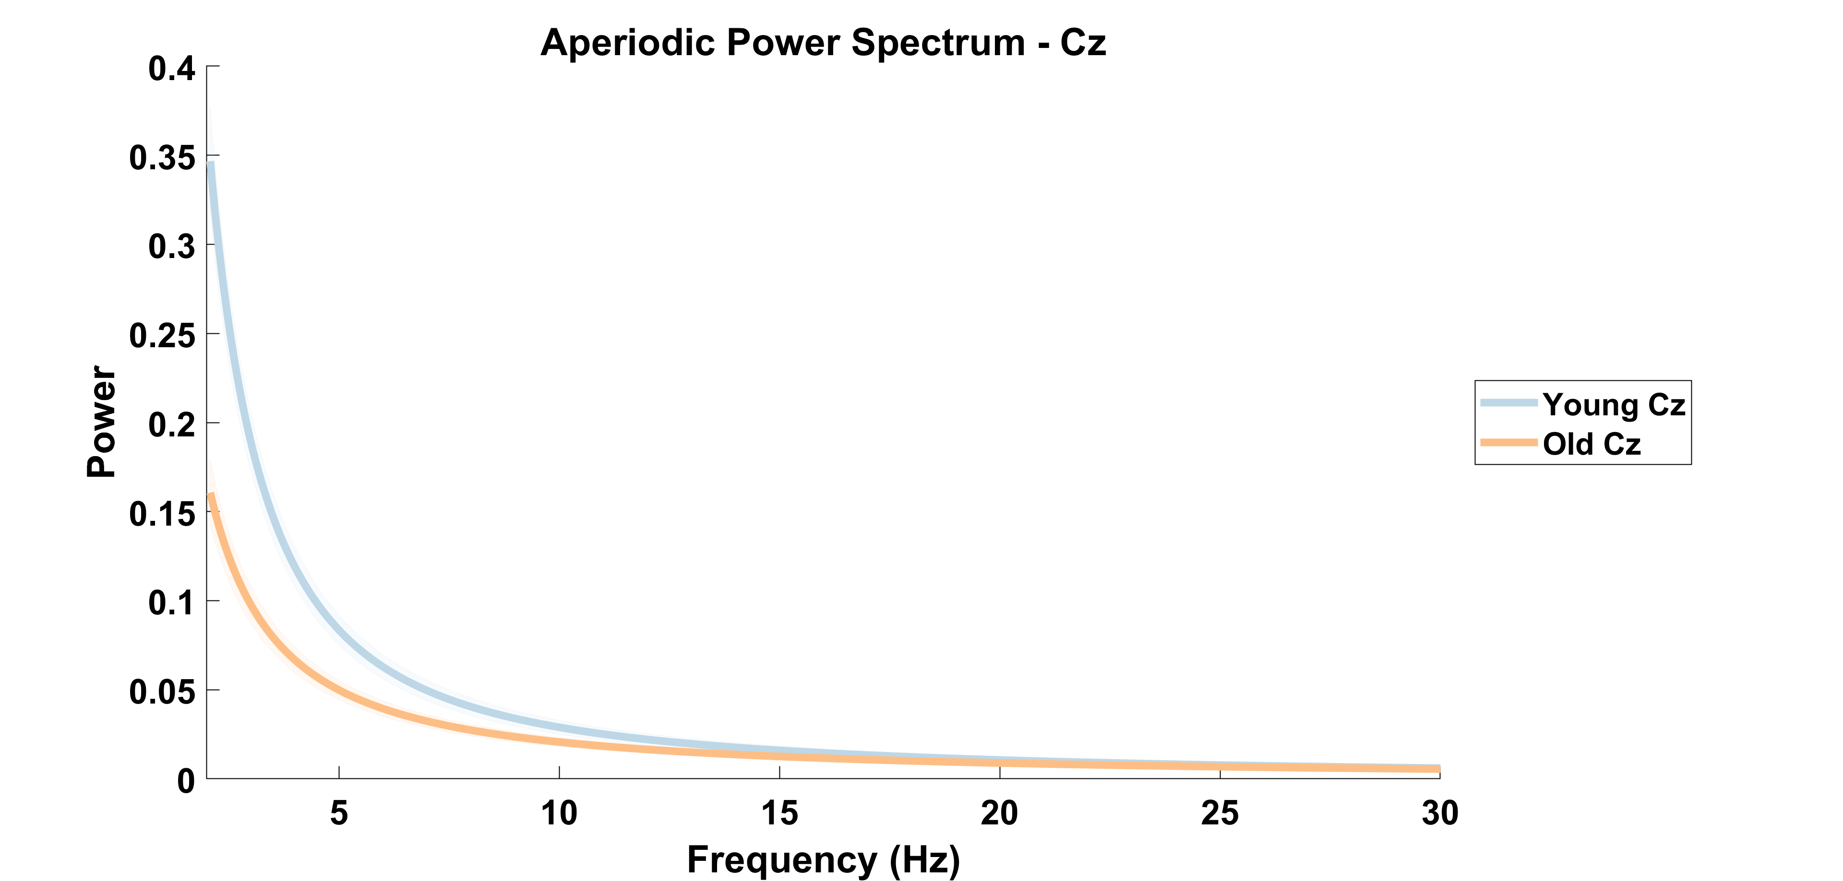

Slide 8
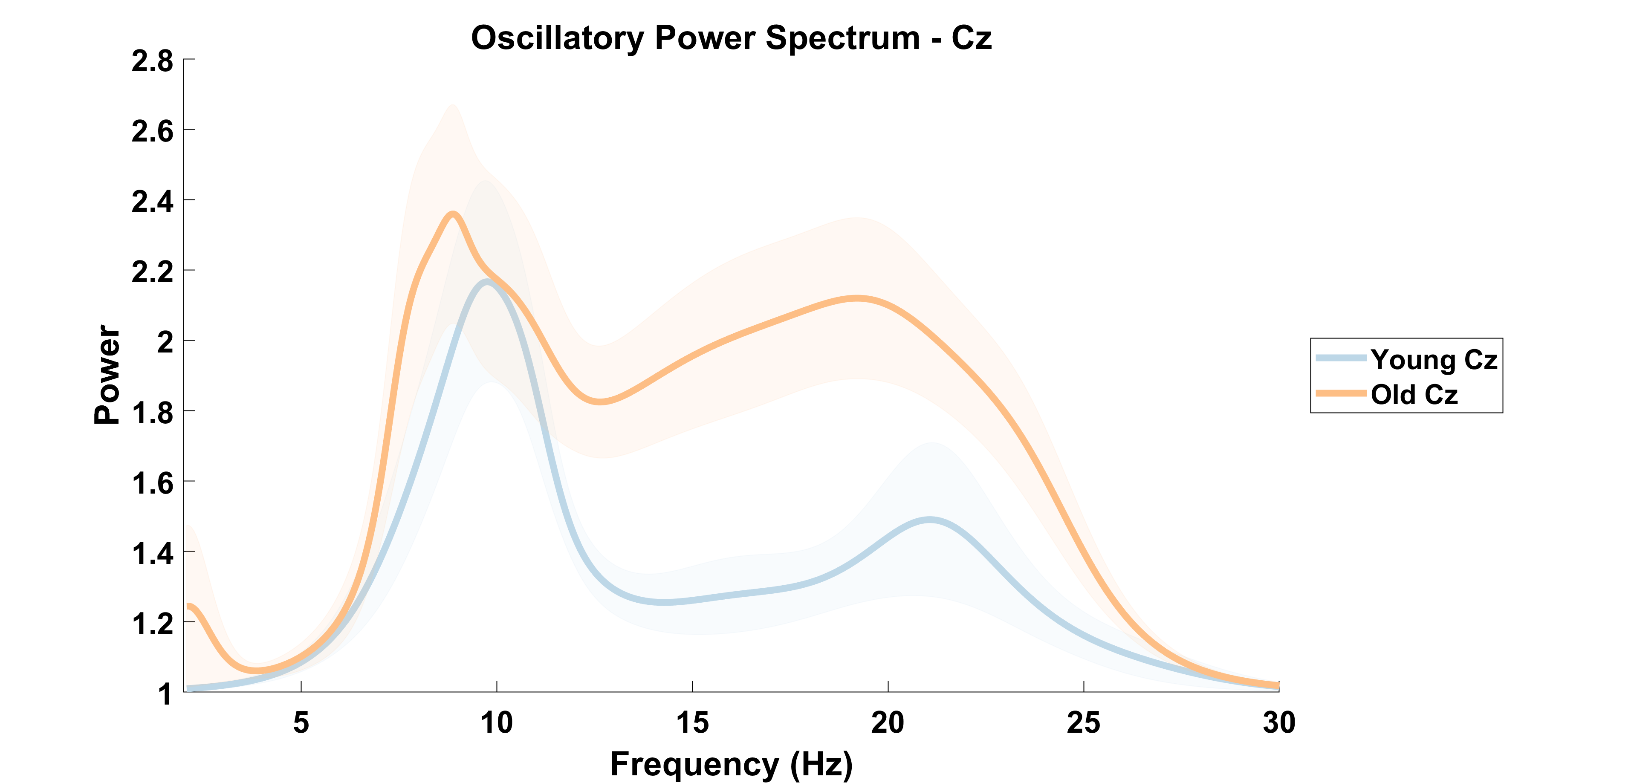

Slide 9
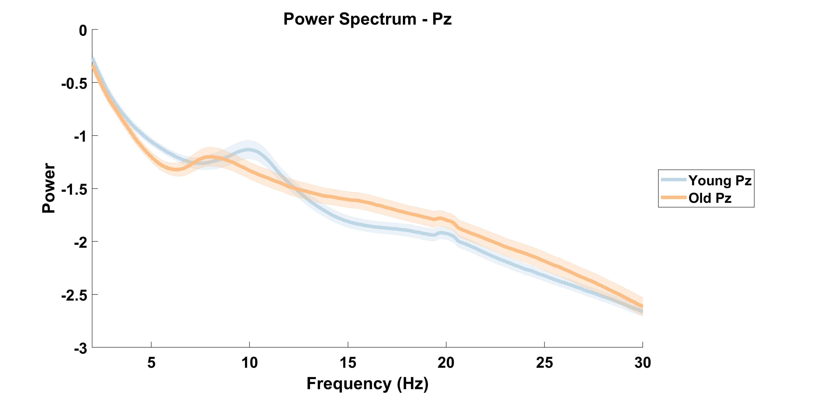

Slide 10
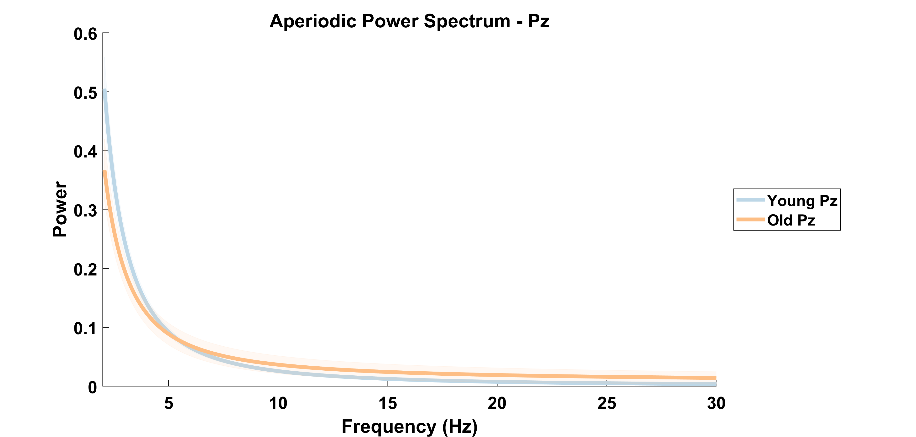

Slide 11
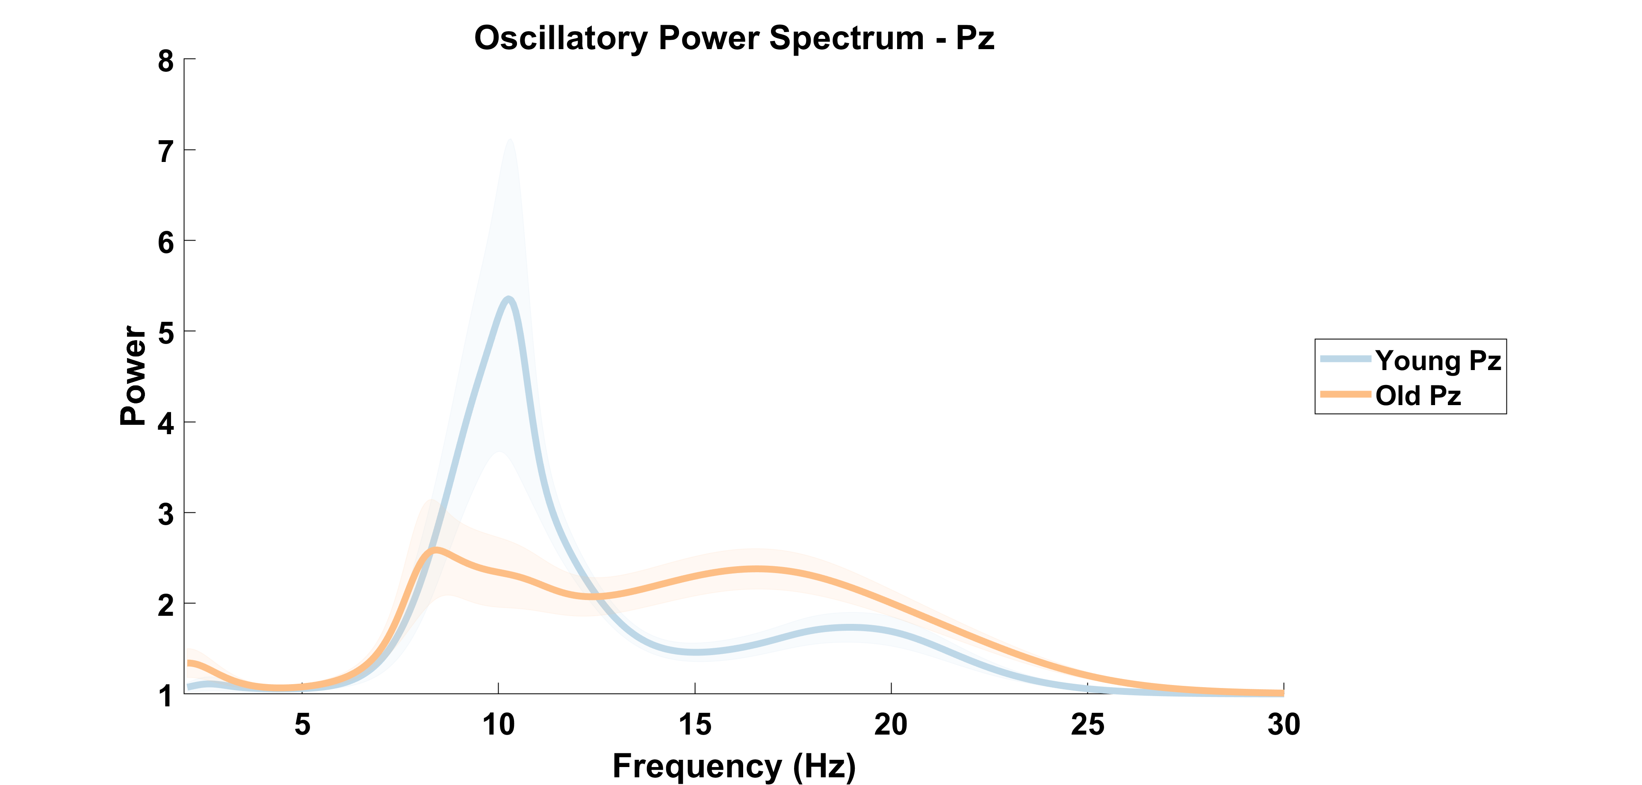

Slide 12
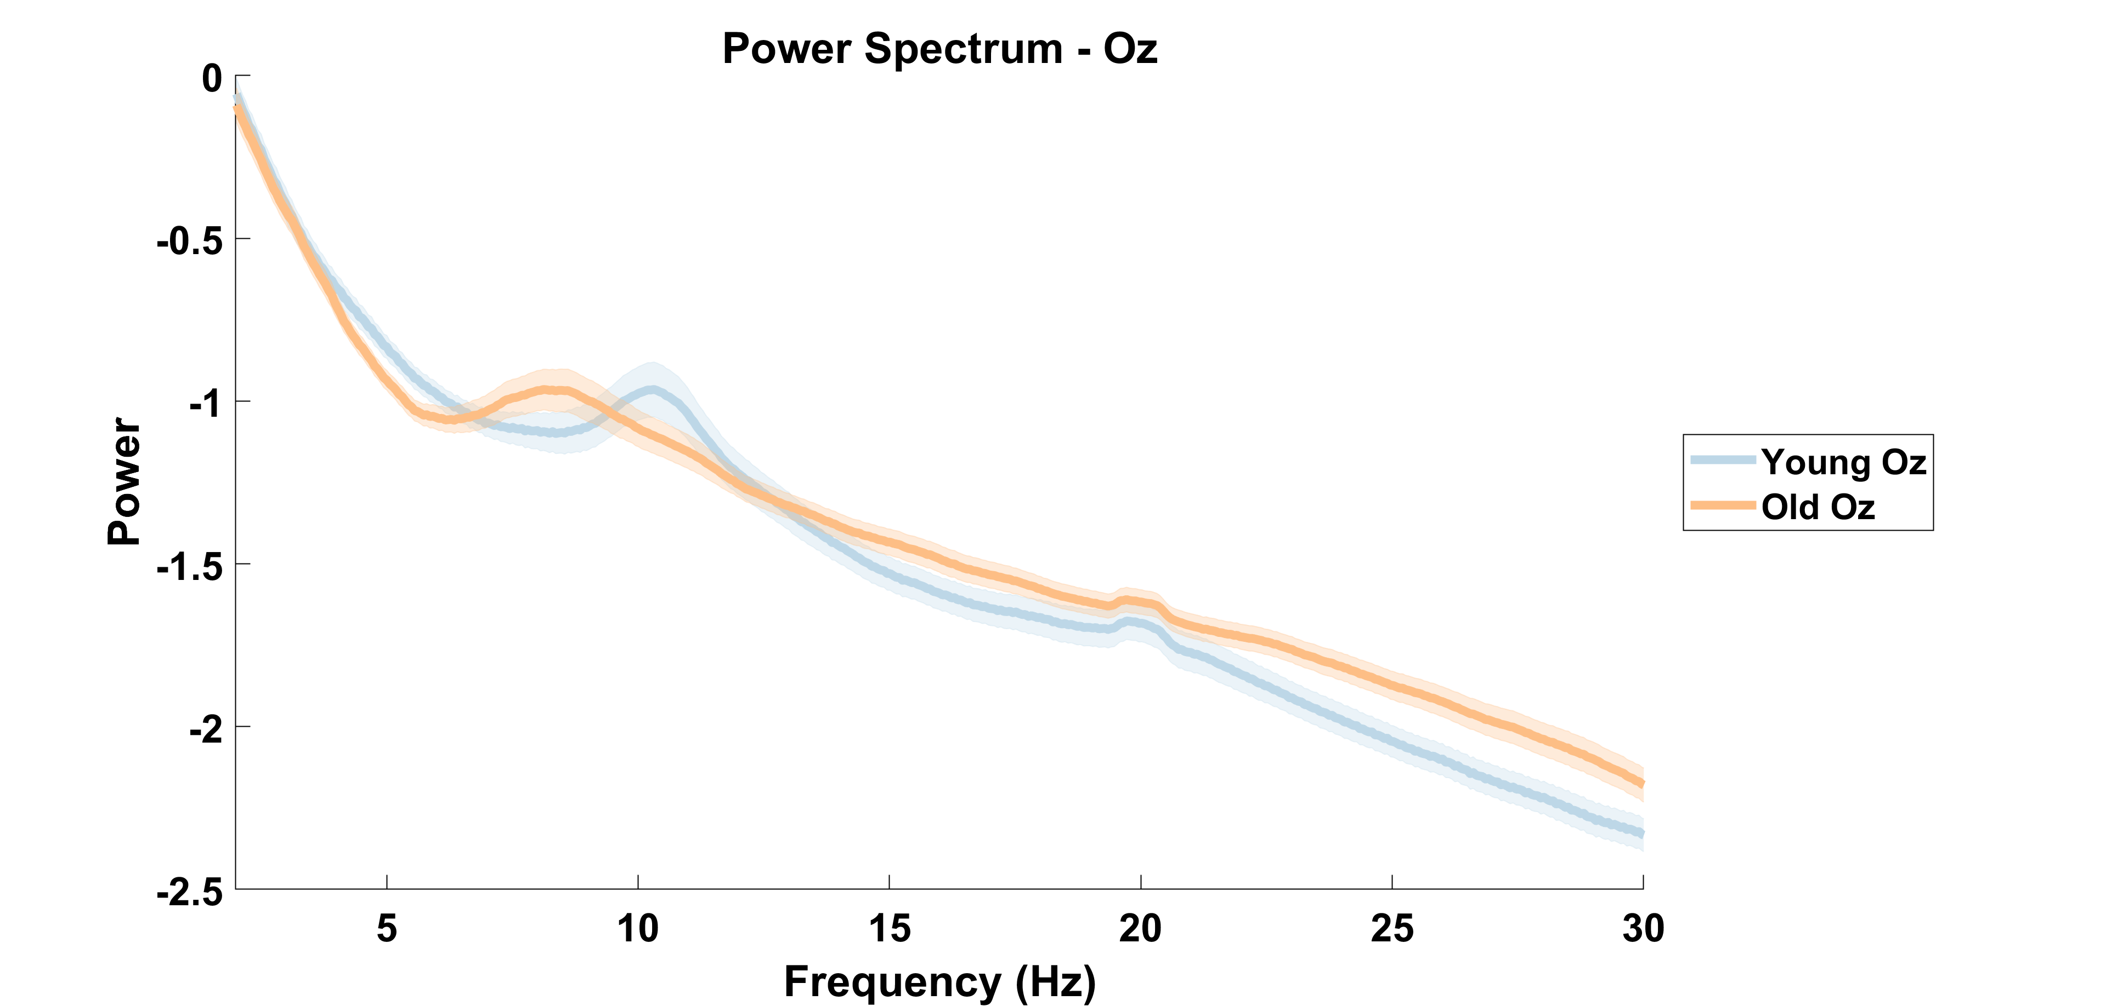

Slide 13
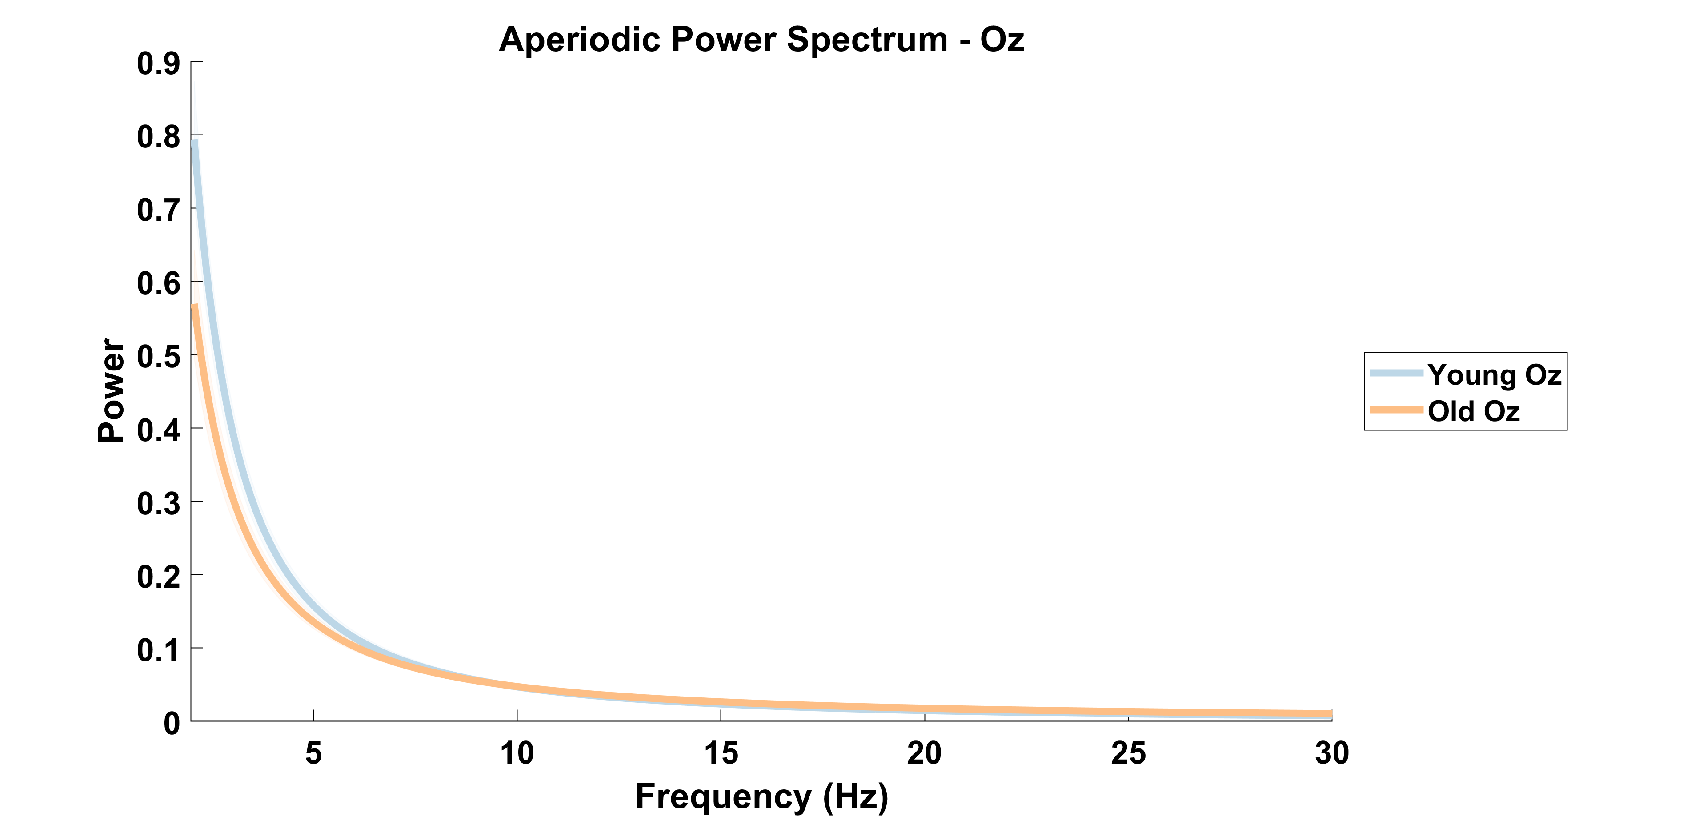

Slide 14
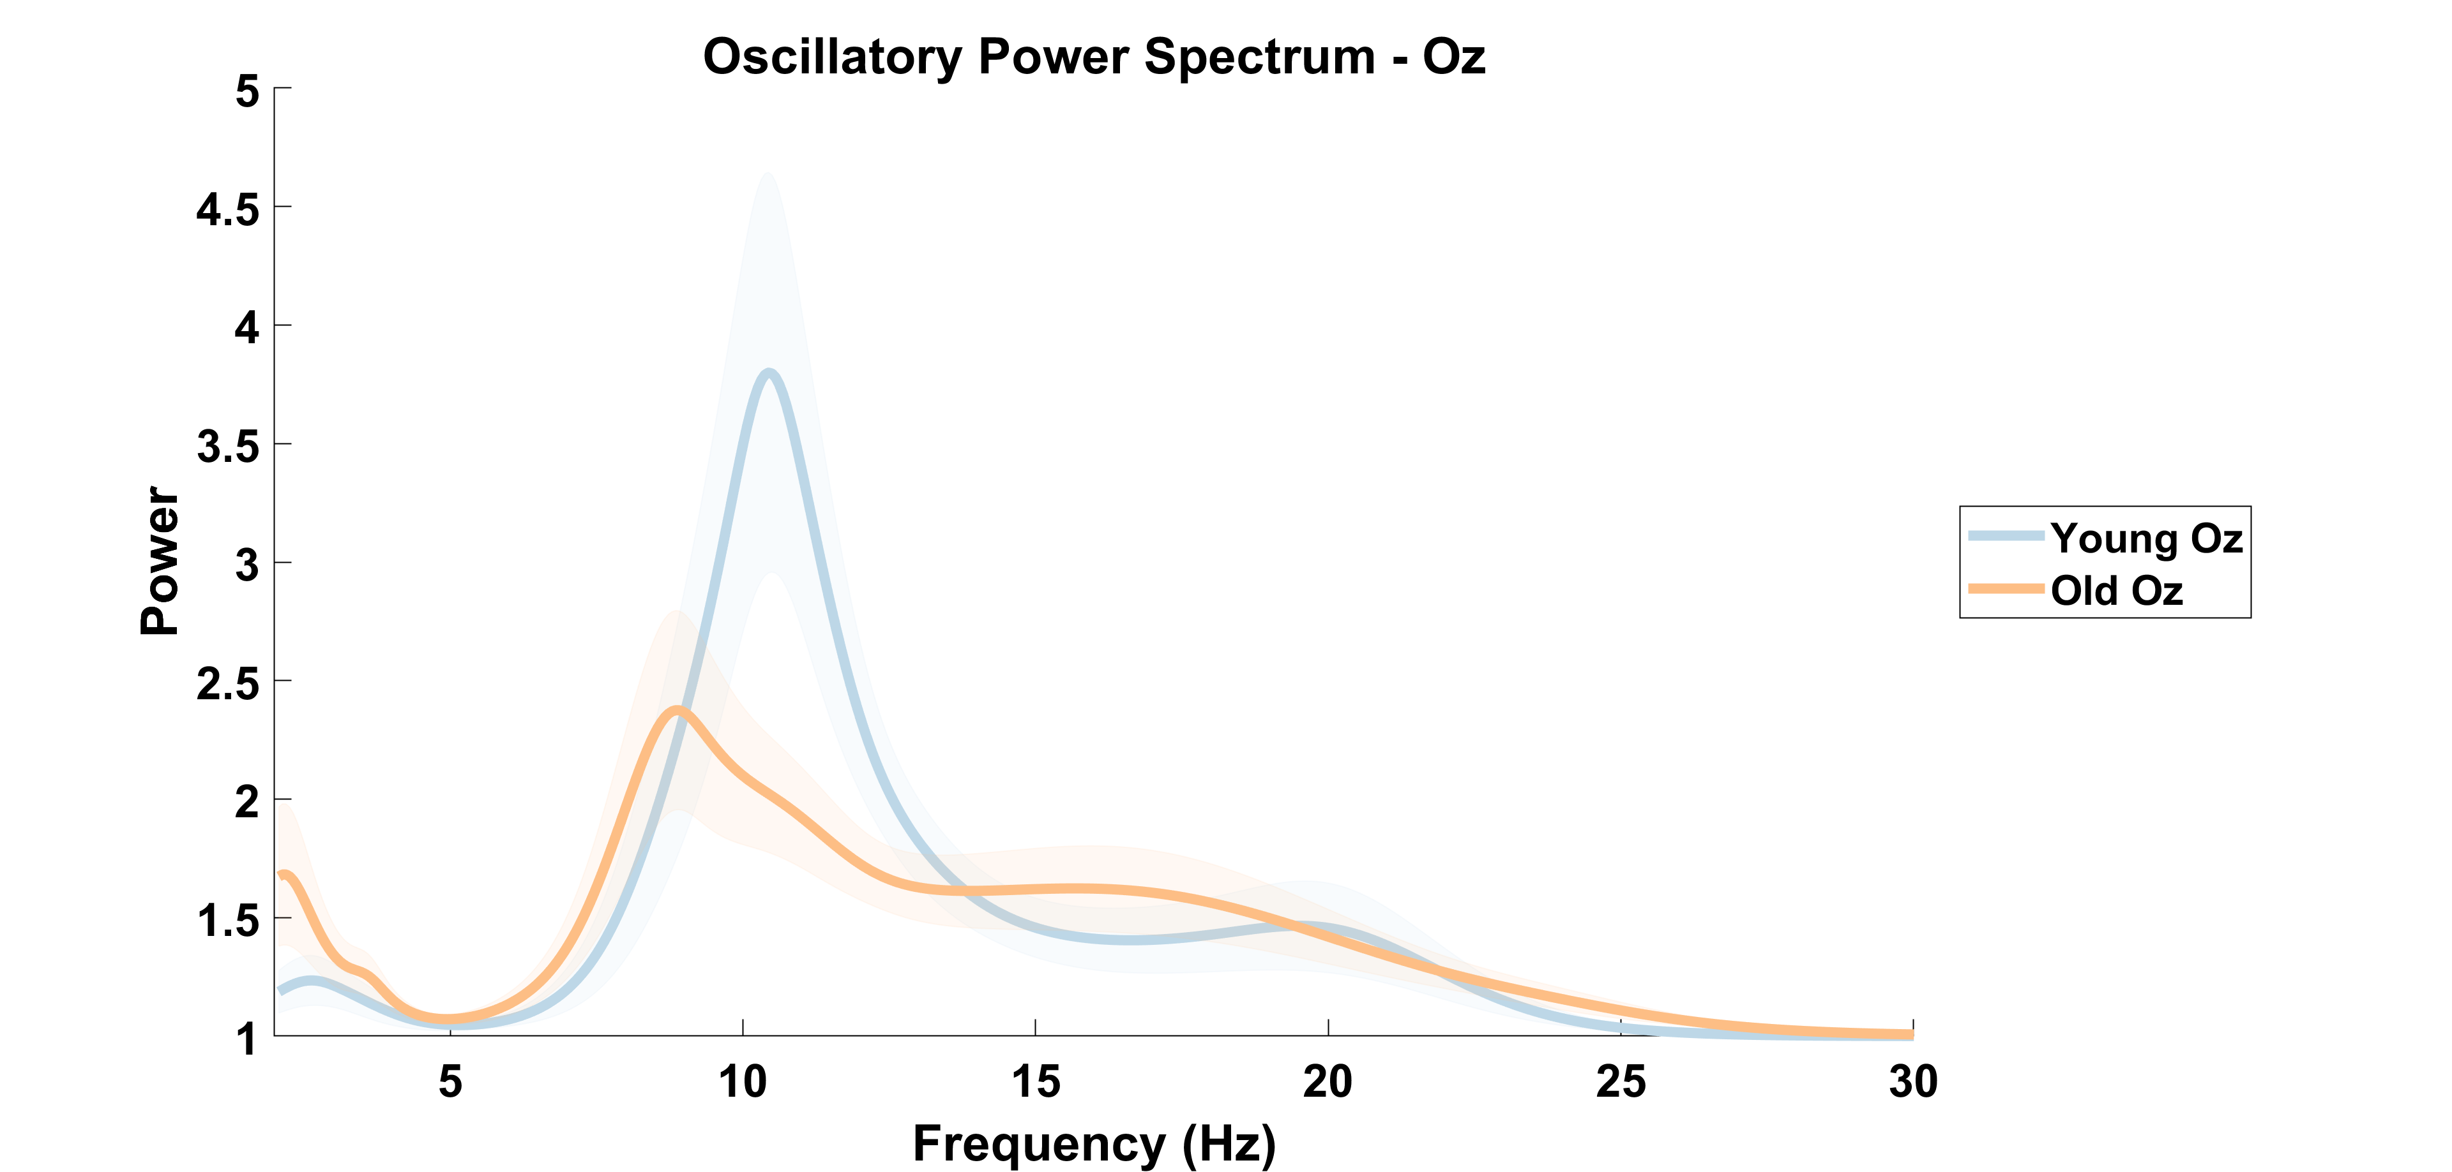

Slide 15
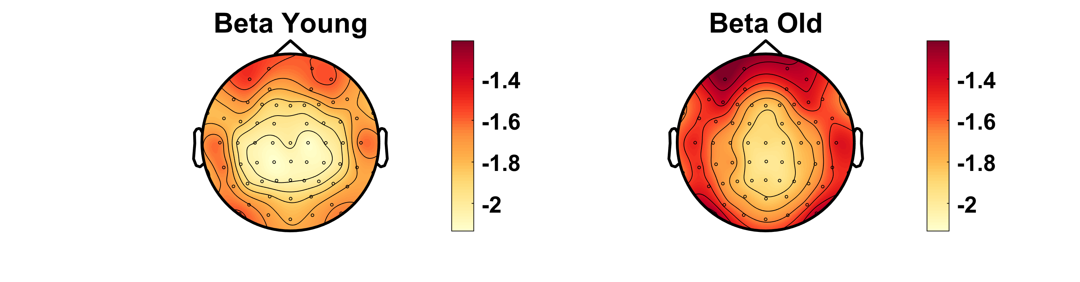
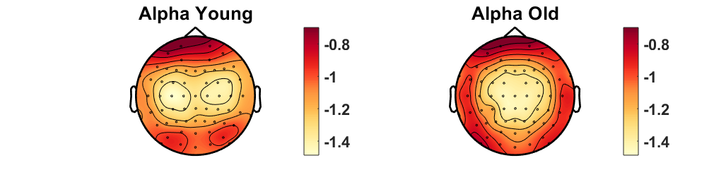
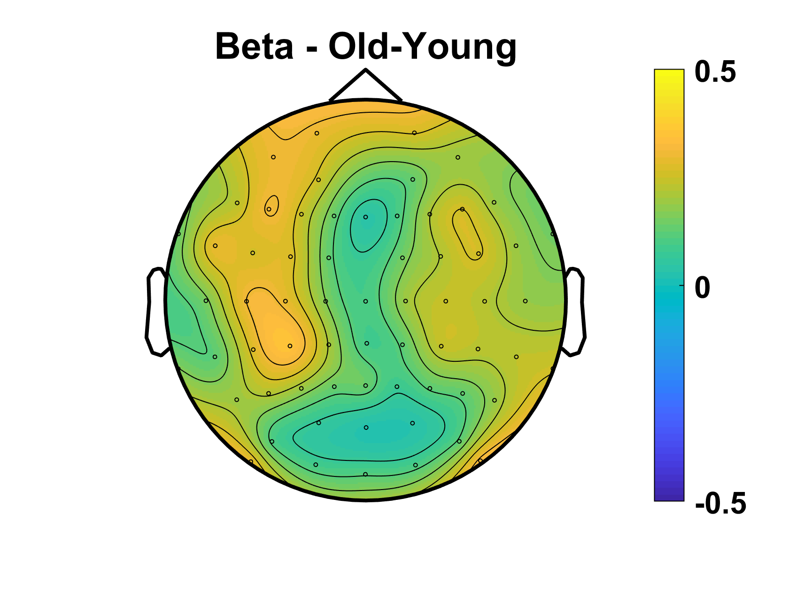
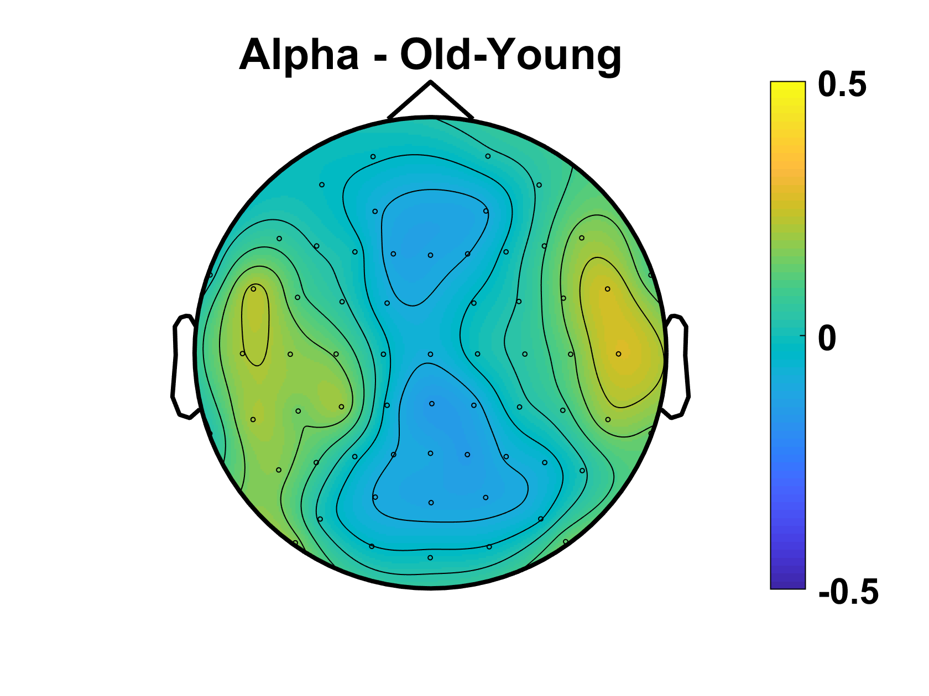
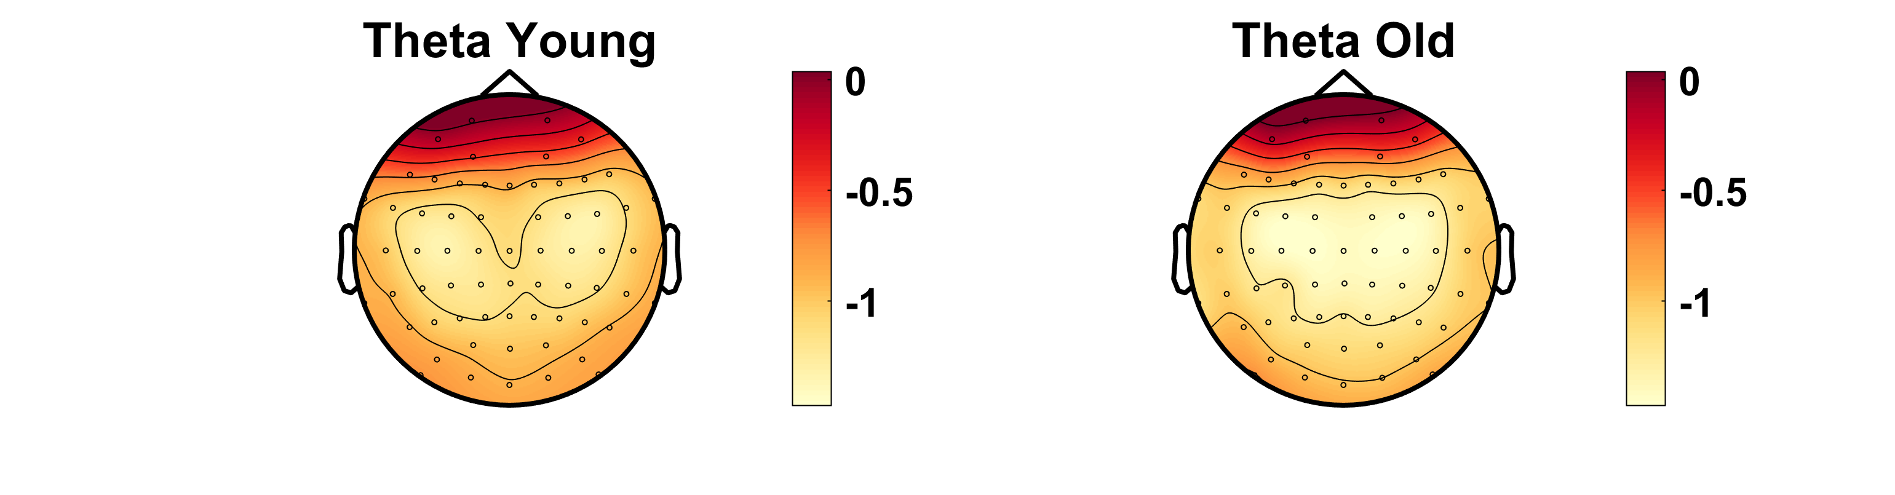
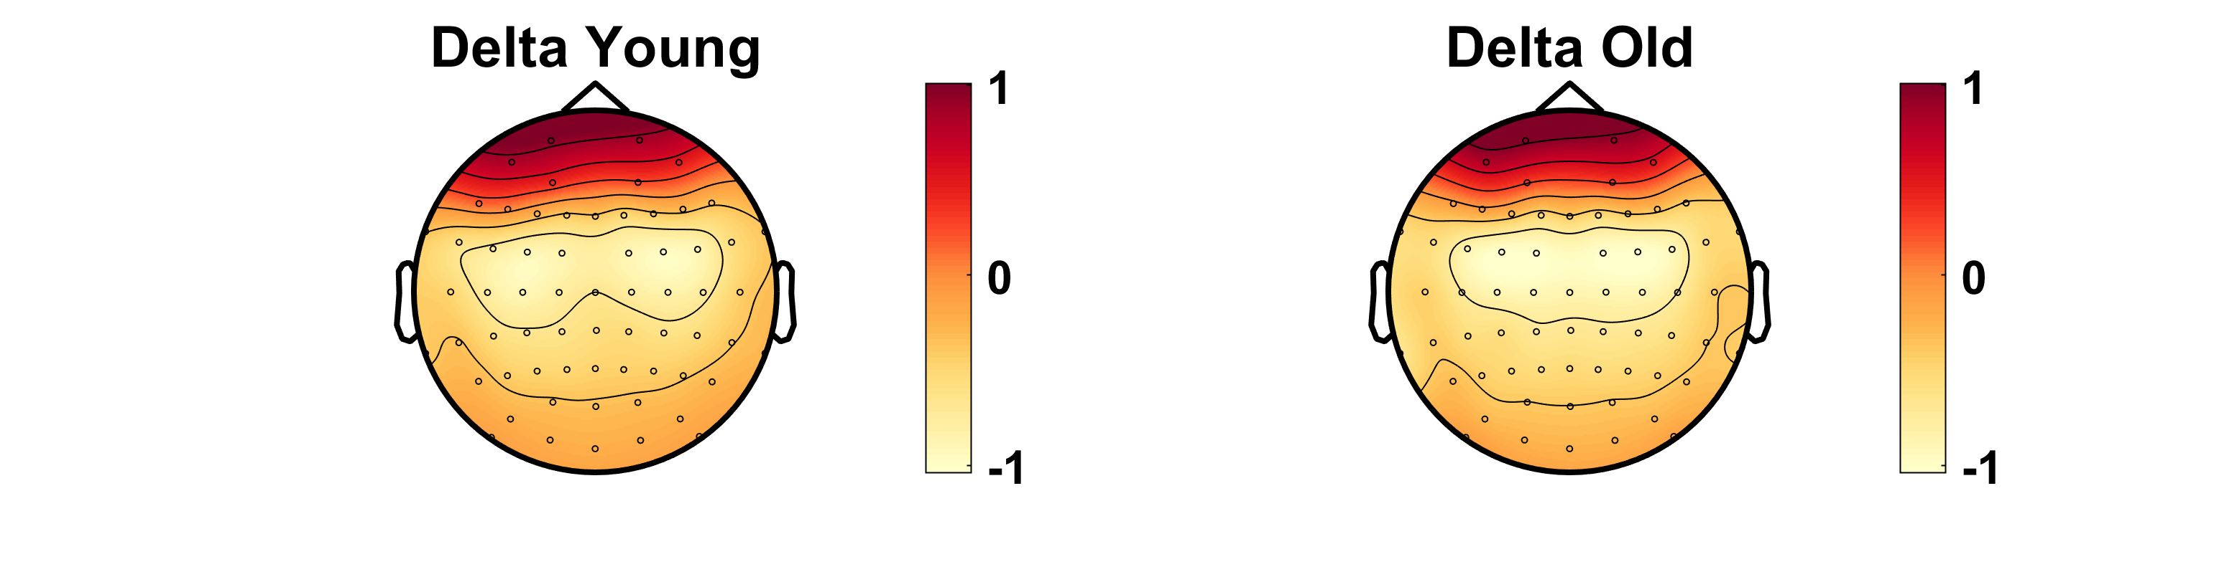
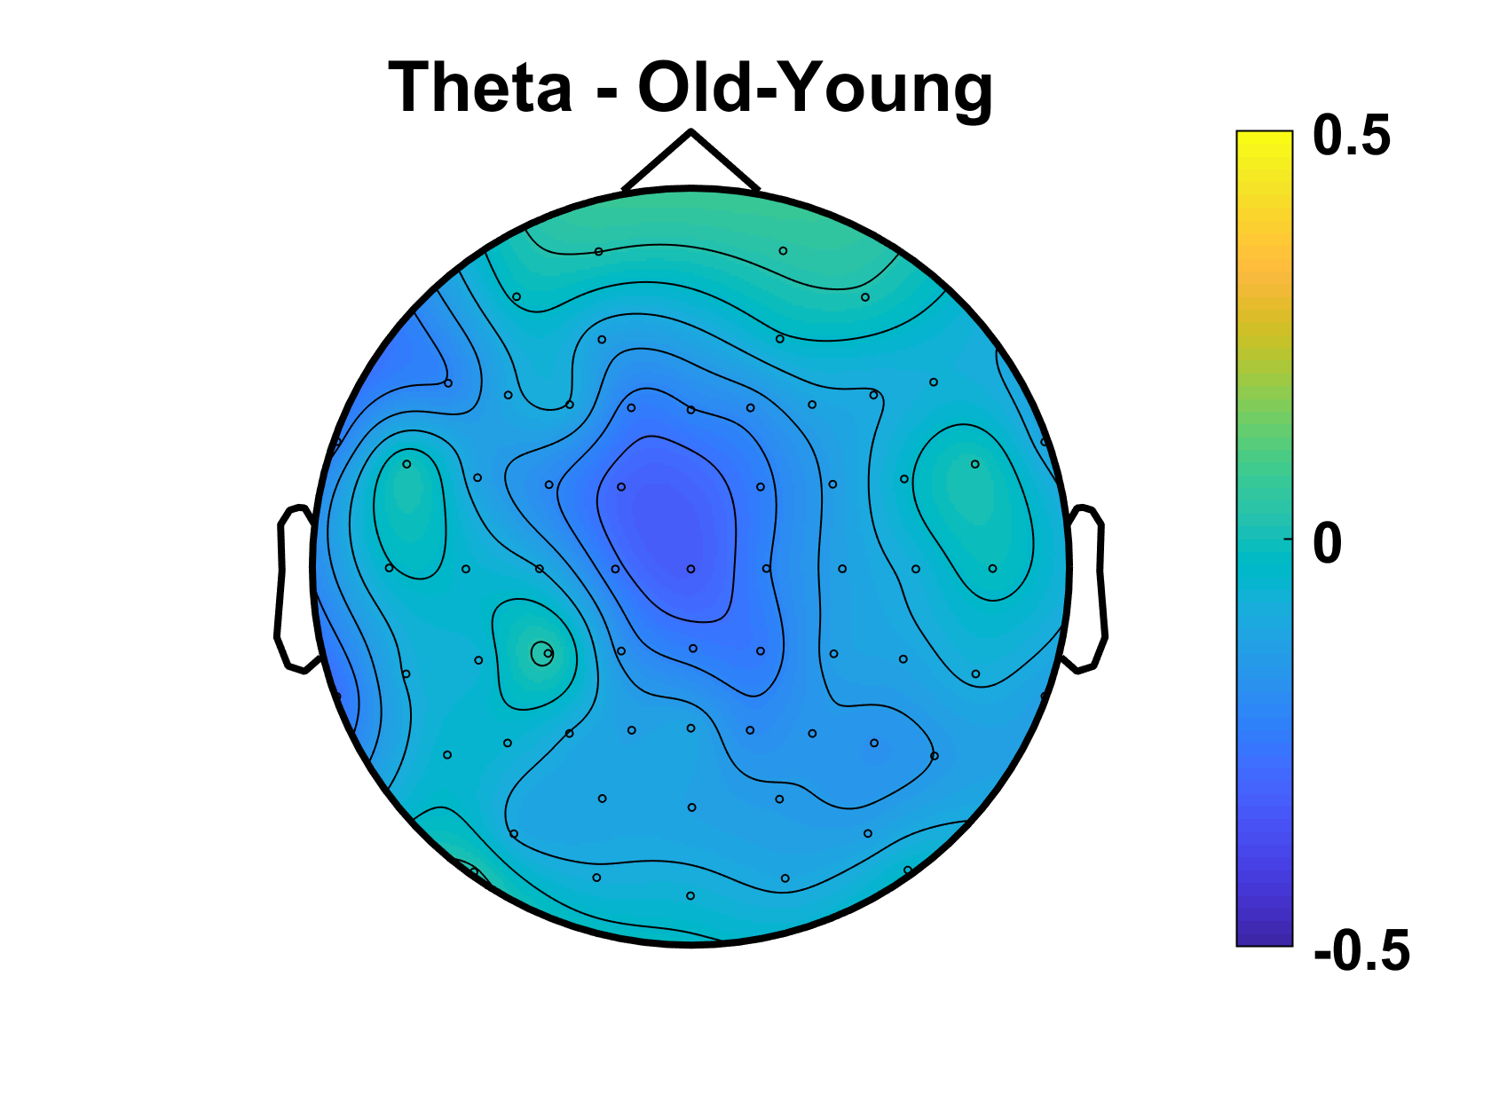
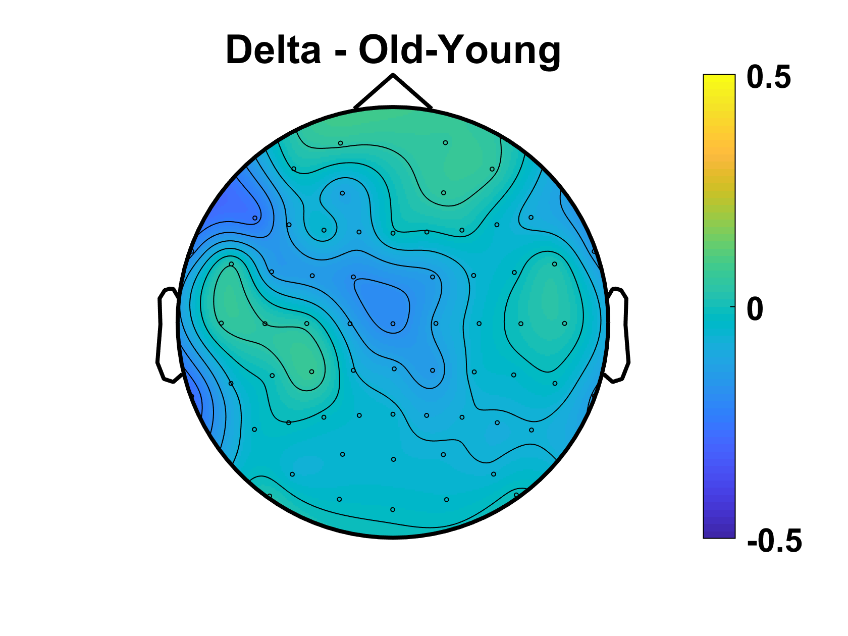
Power
No sig difference in Oz/((O1+O2)/2) ratio
p=.95
Notes:
REPLICATE TOPOGRAPHIES with all_osci (new scripts) – DONE (next slide)
+ differences old-young for each freq band - DONE

Slide 16
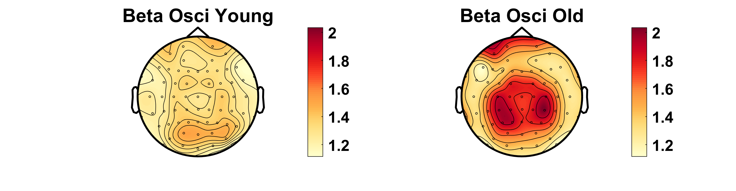
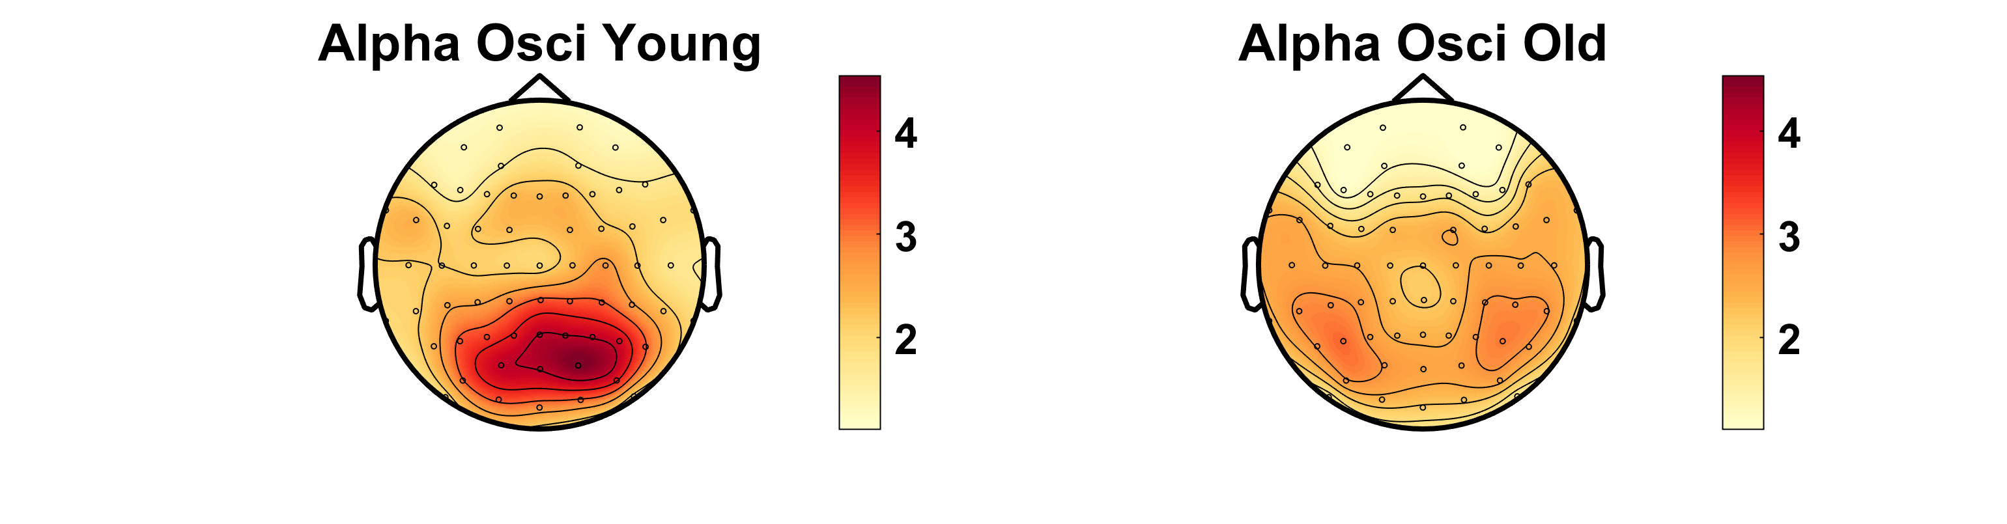
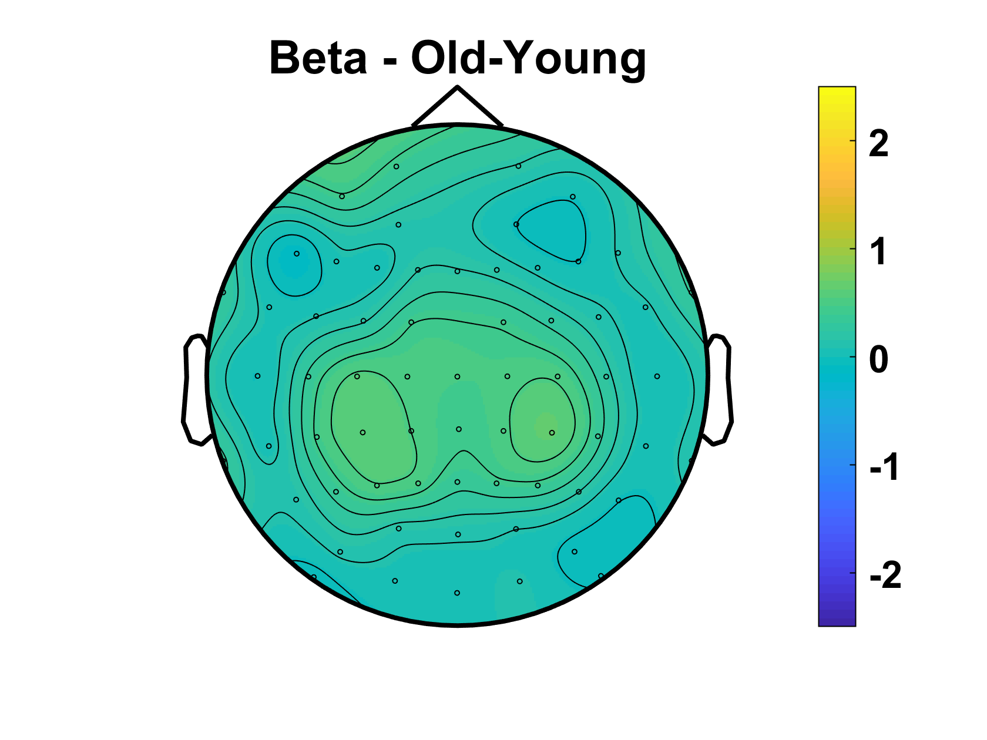
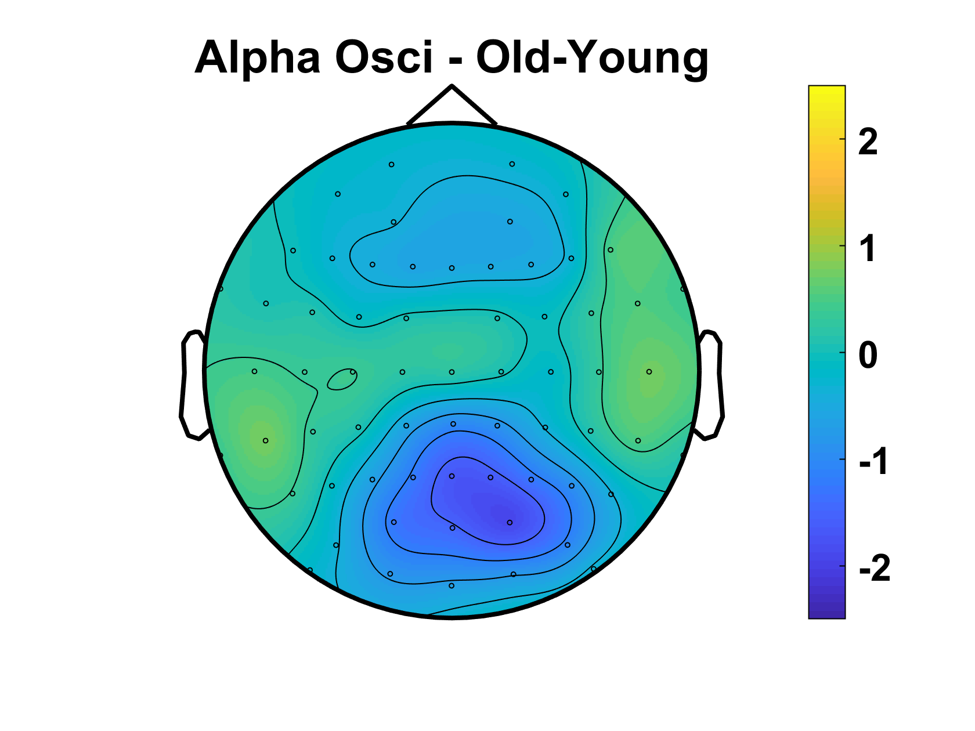
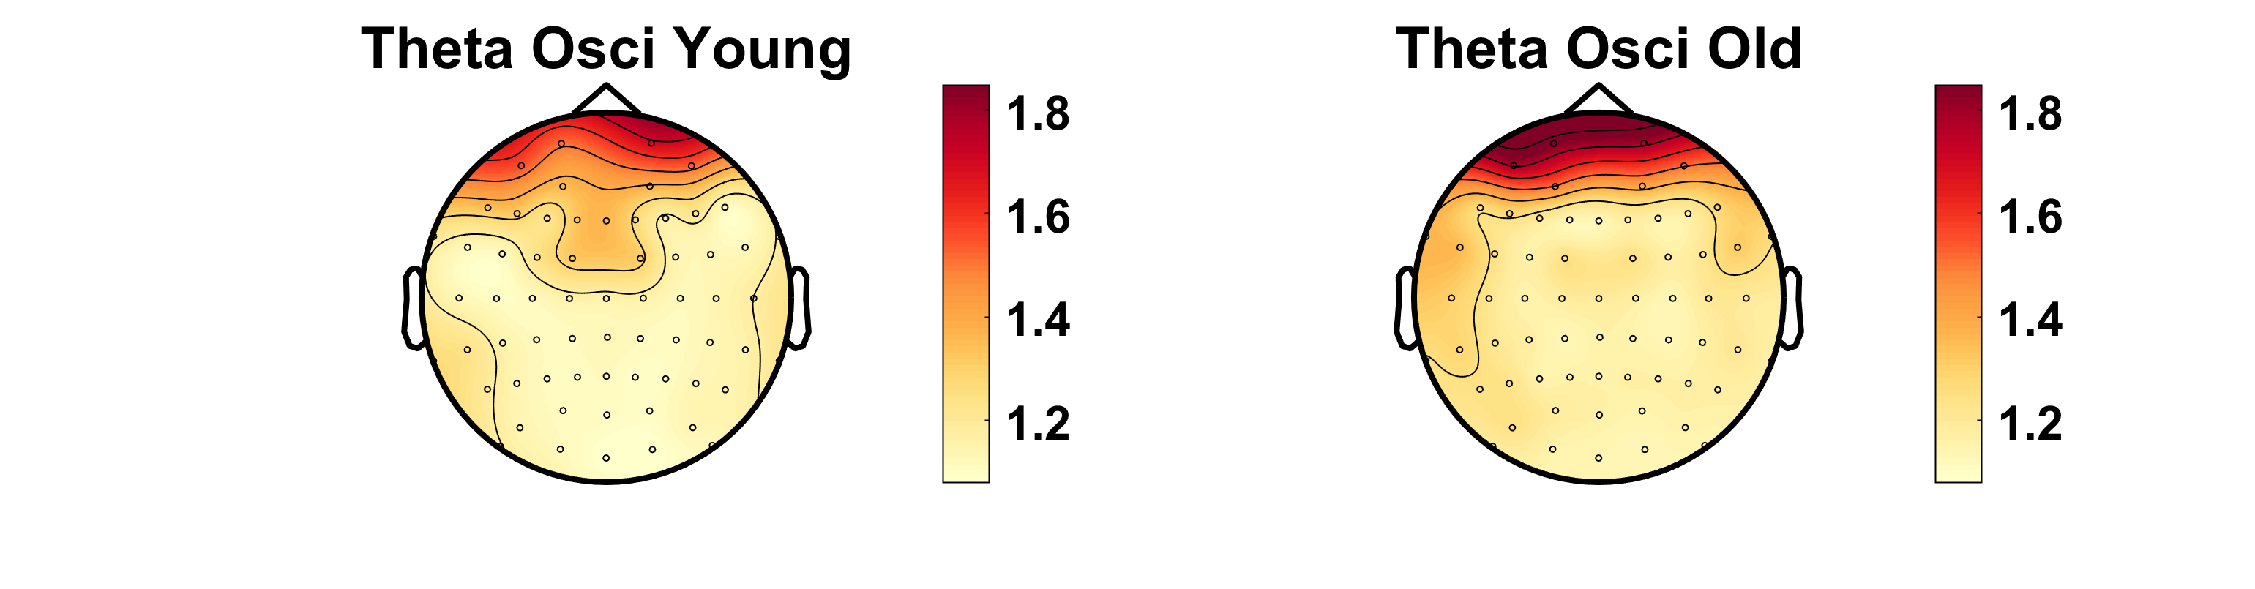
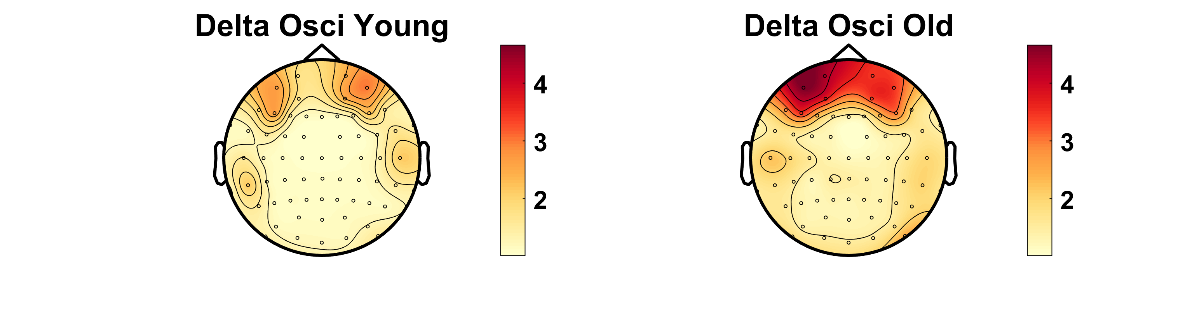
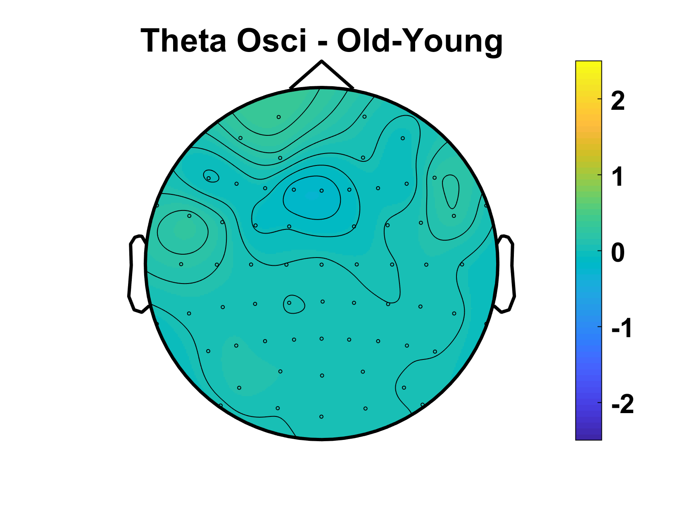
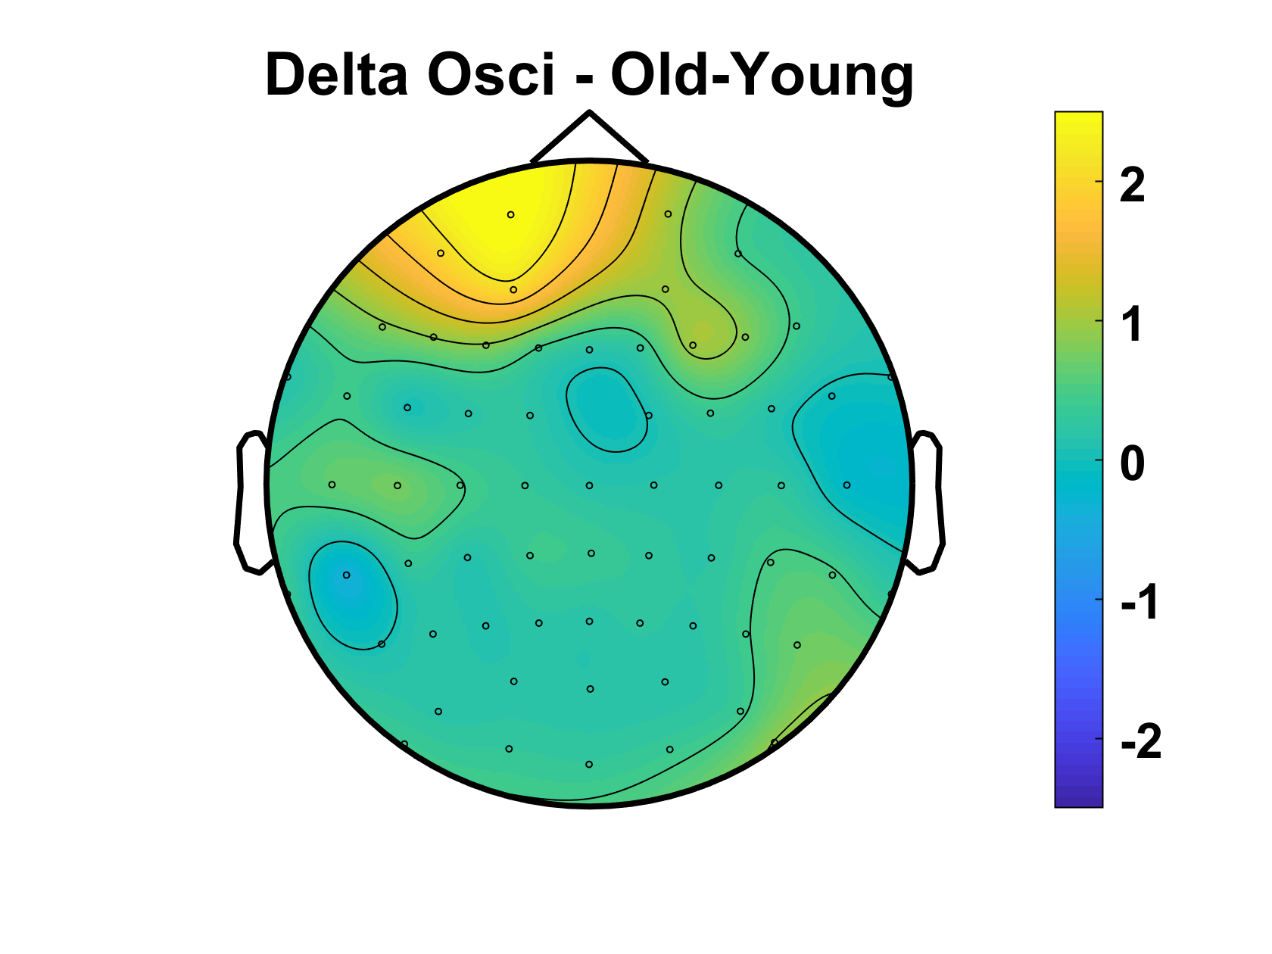
Oscillatory Component
No sig difference in Oz/((O1+O2)/2) ratio
p=.69
Notes:
REPLICATE TOPOGRAPHIES with all_osci (new scripts) – DONE (next slide)
+ differences old-young for each freq band - DONE

Slide 17
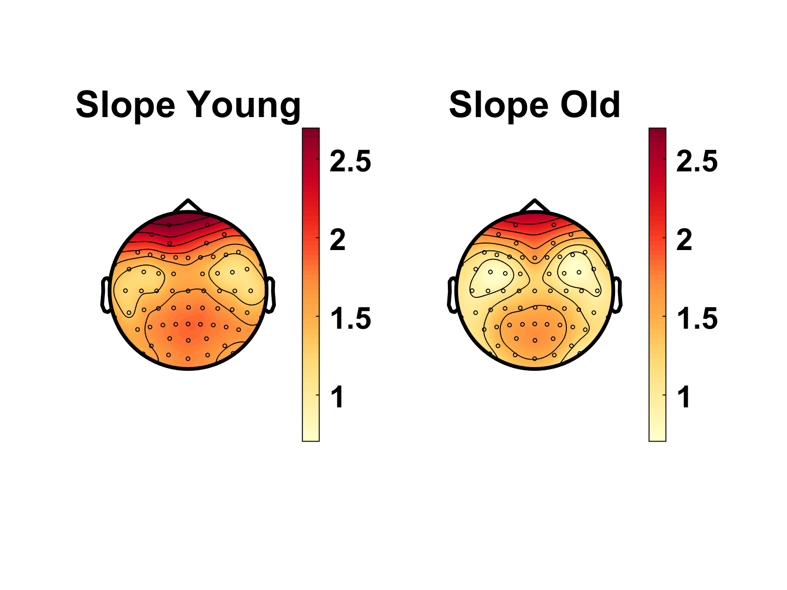
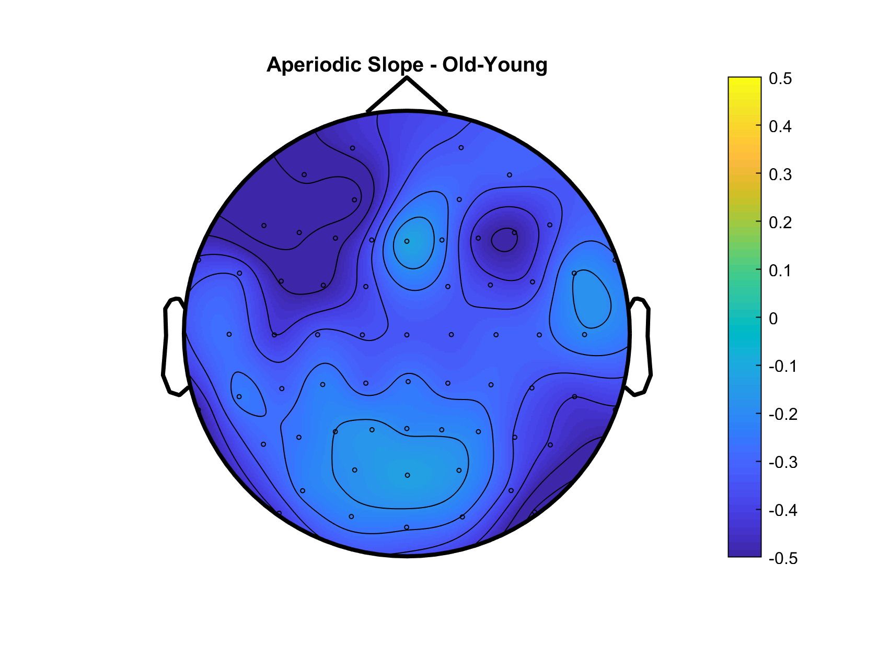
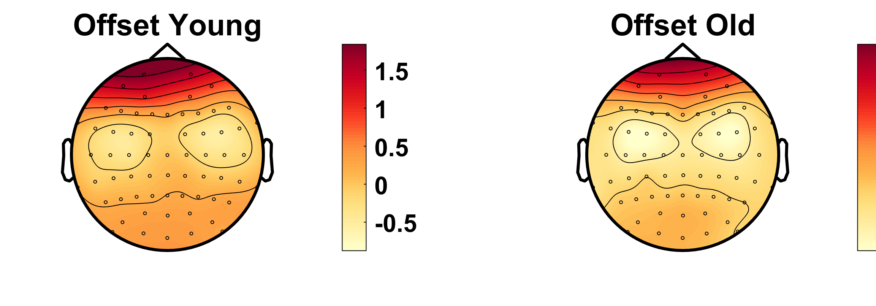
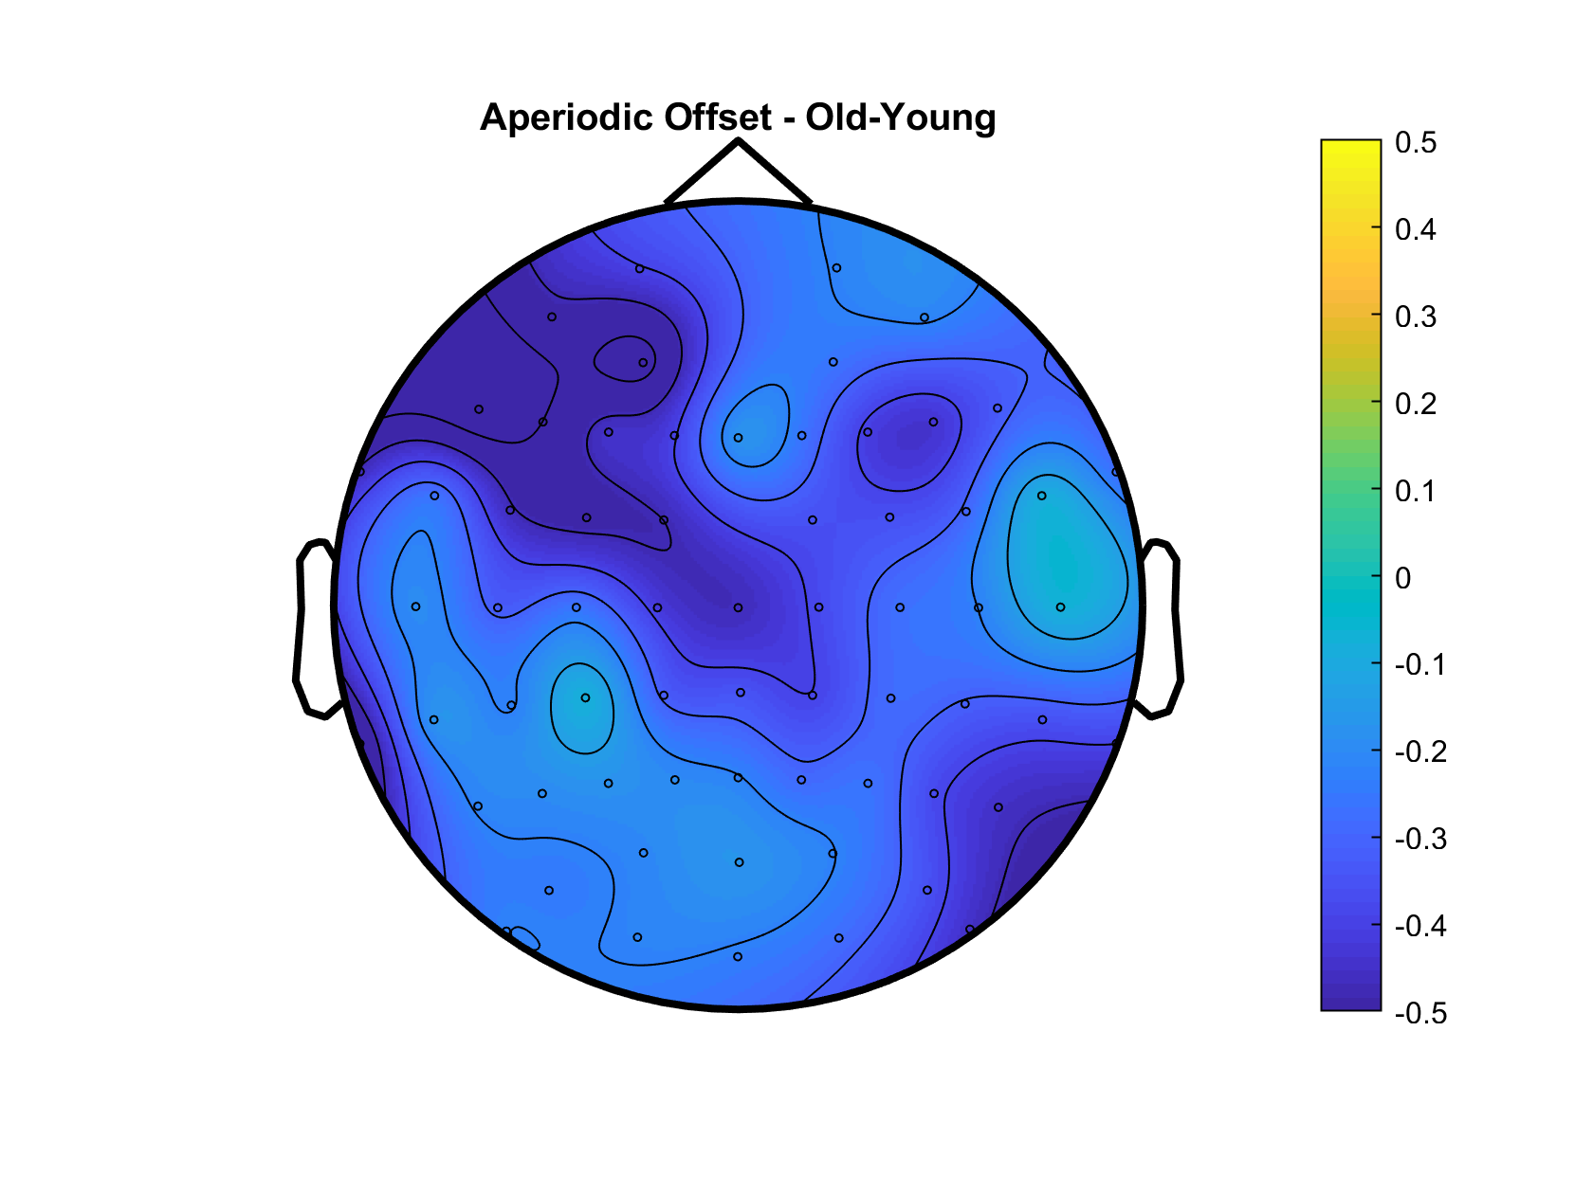
Aperiodic Slope – Younger 90% vs Older 90%
Aperiodic Offset – Younger 90% vs Older 90%
Notes:
Add old-young difference topograpjy - DONE

Slide 18
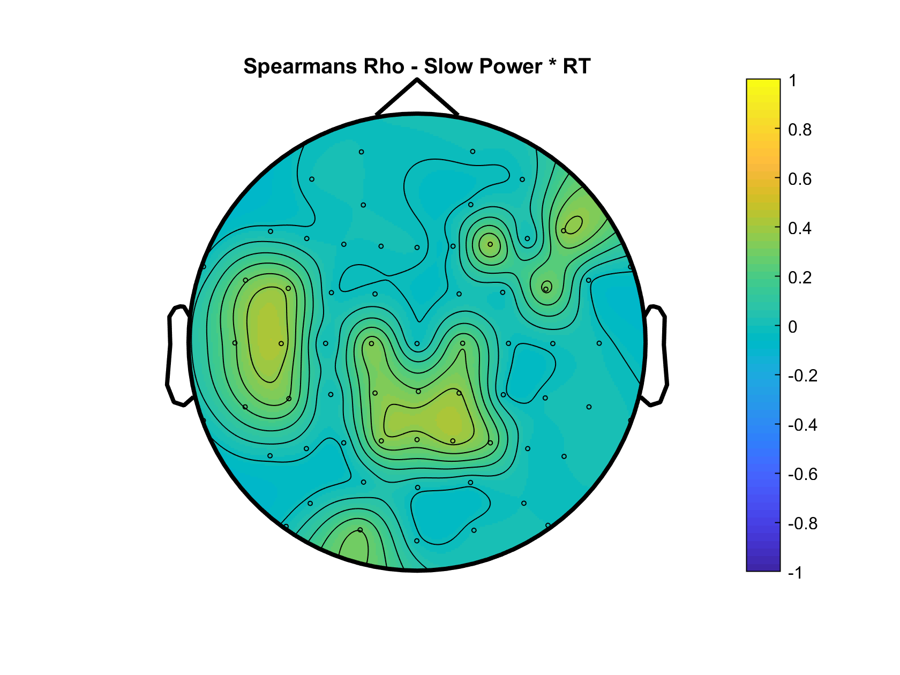
Oscillatory Theta x Behaviour

Slide 19
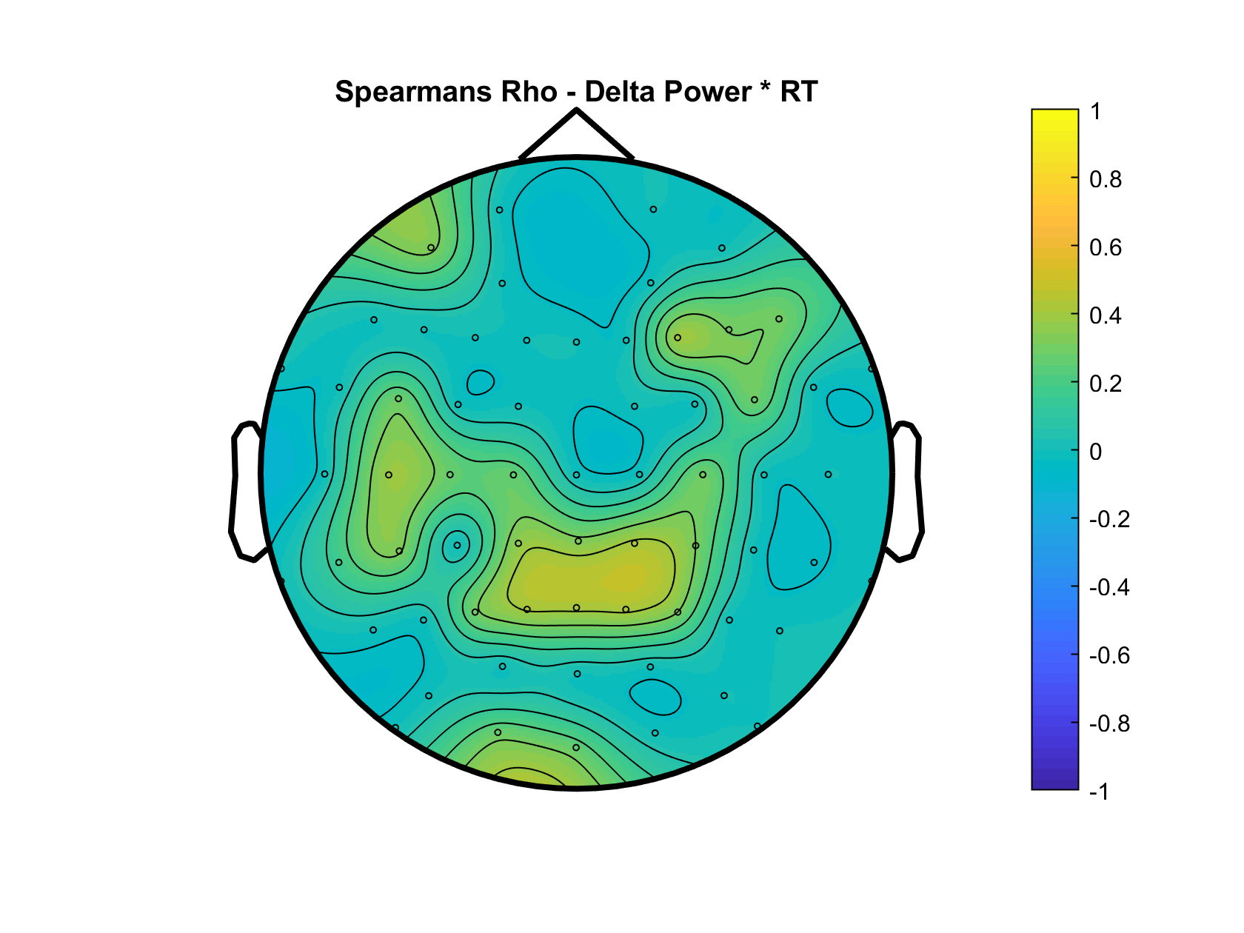
Oscillatory Theta x Behaviour

Slide 20
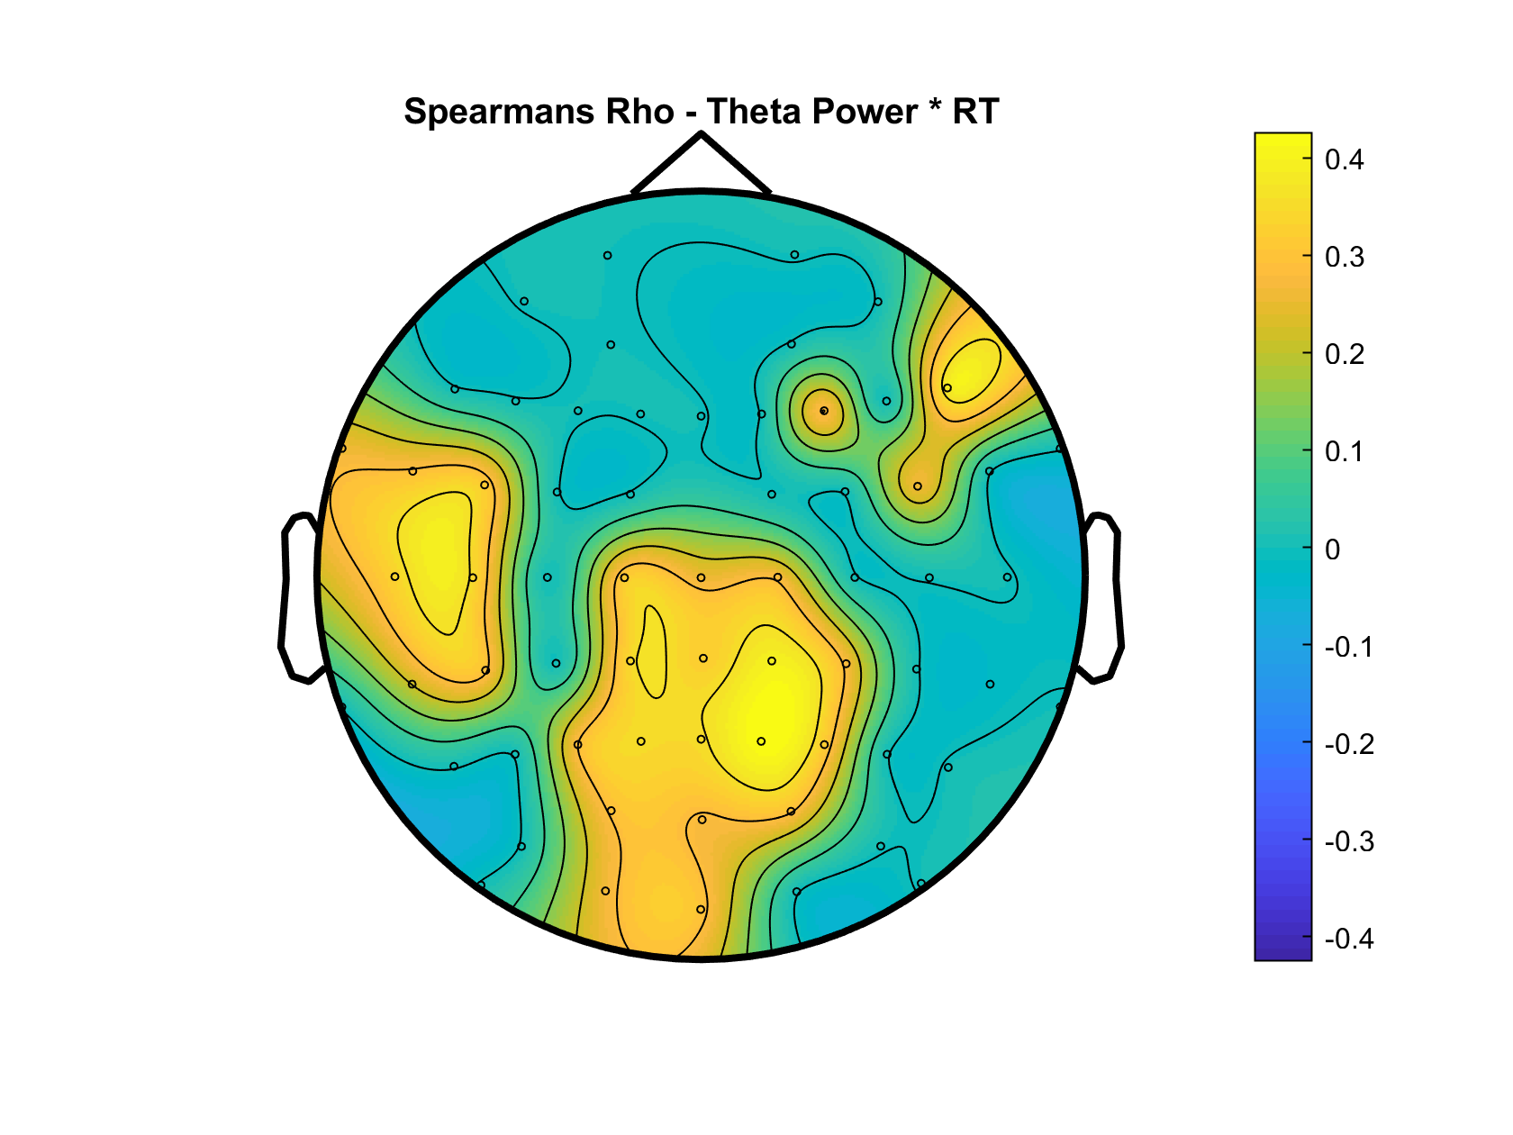
Oscillatory Theta x Behaviour

Slide 21
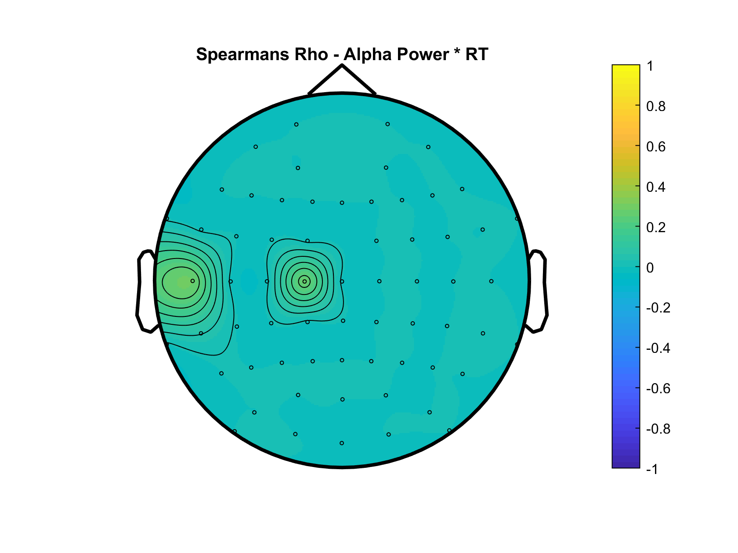
Oscillatory Theta x Behaviour

Slide 22
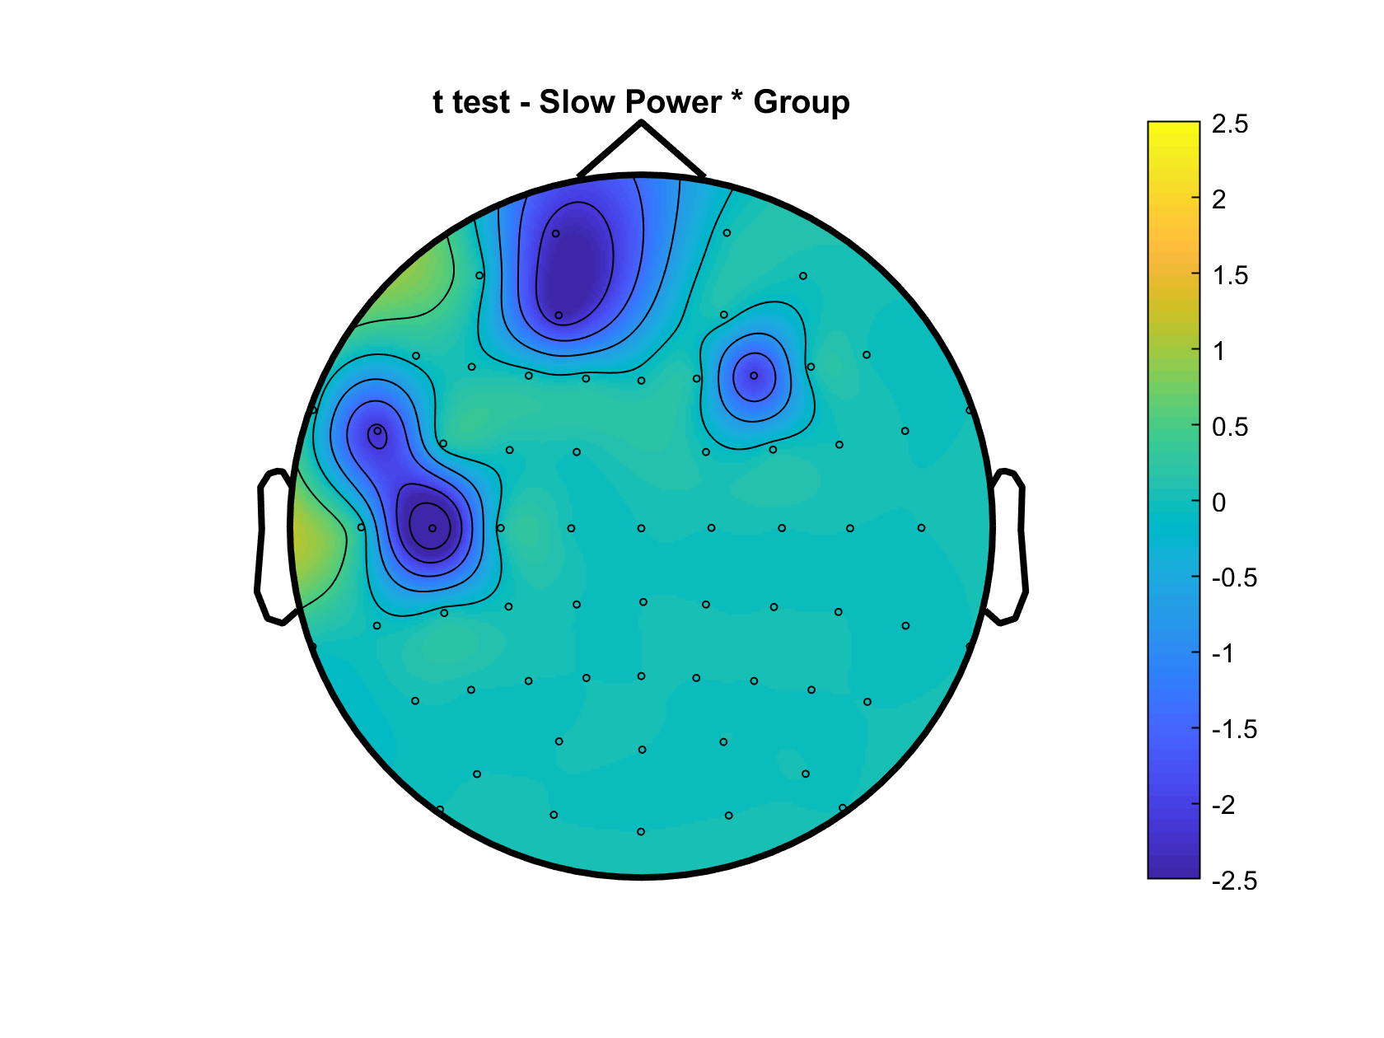
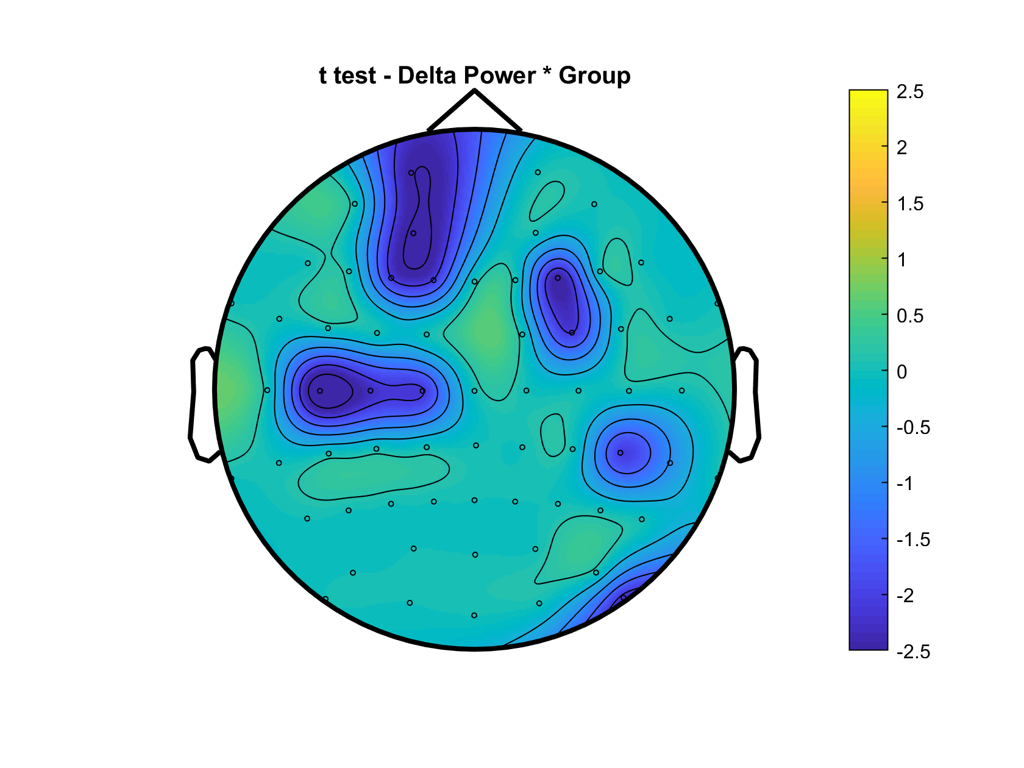
Group Oscillatory Differences

Slide 23
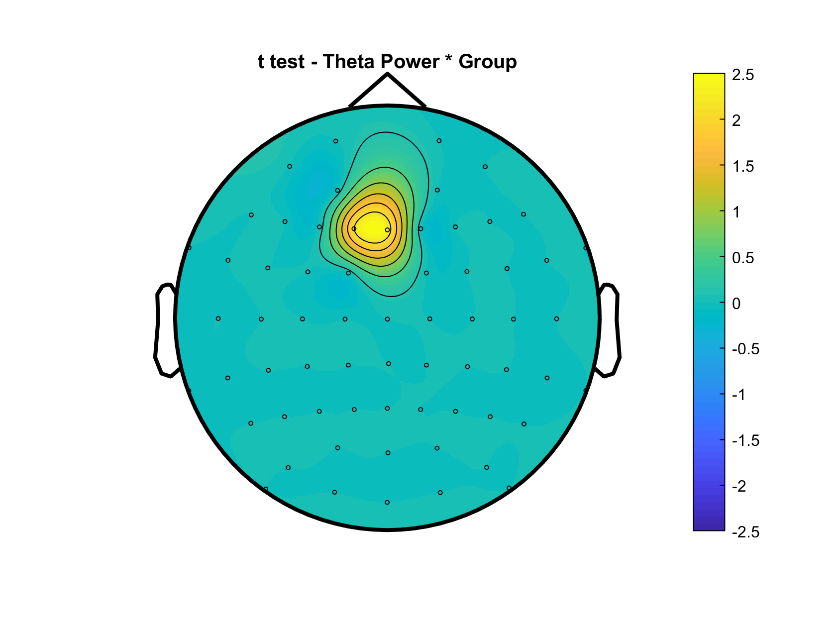
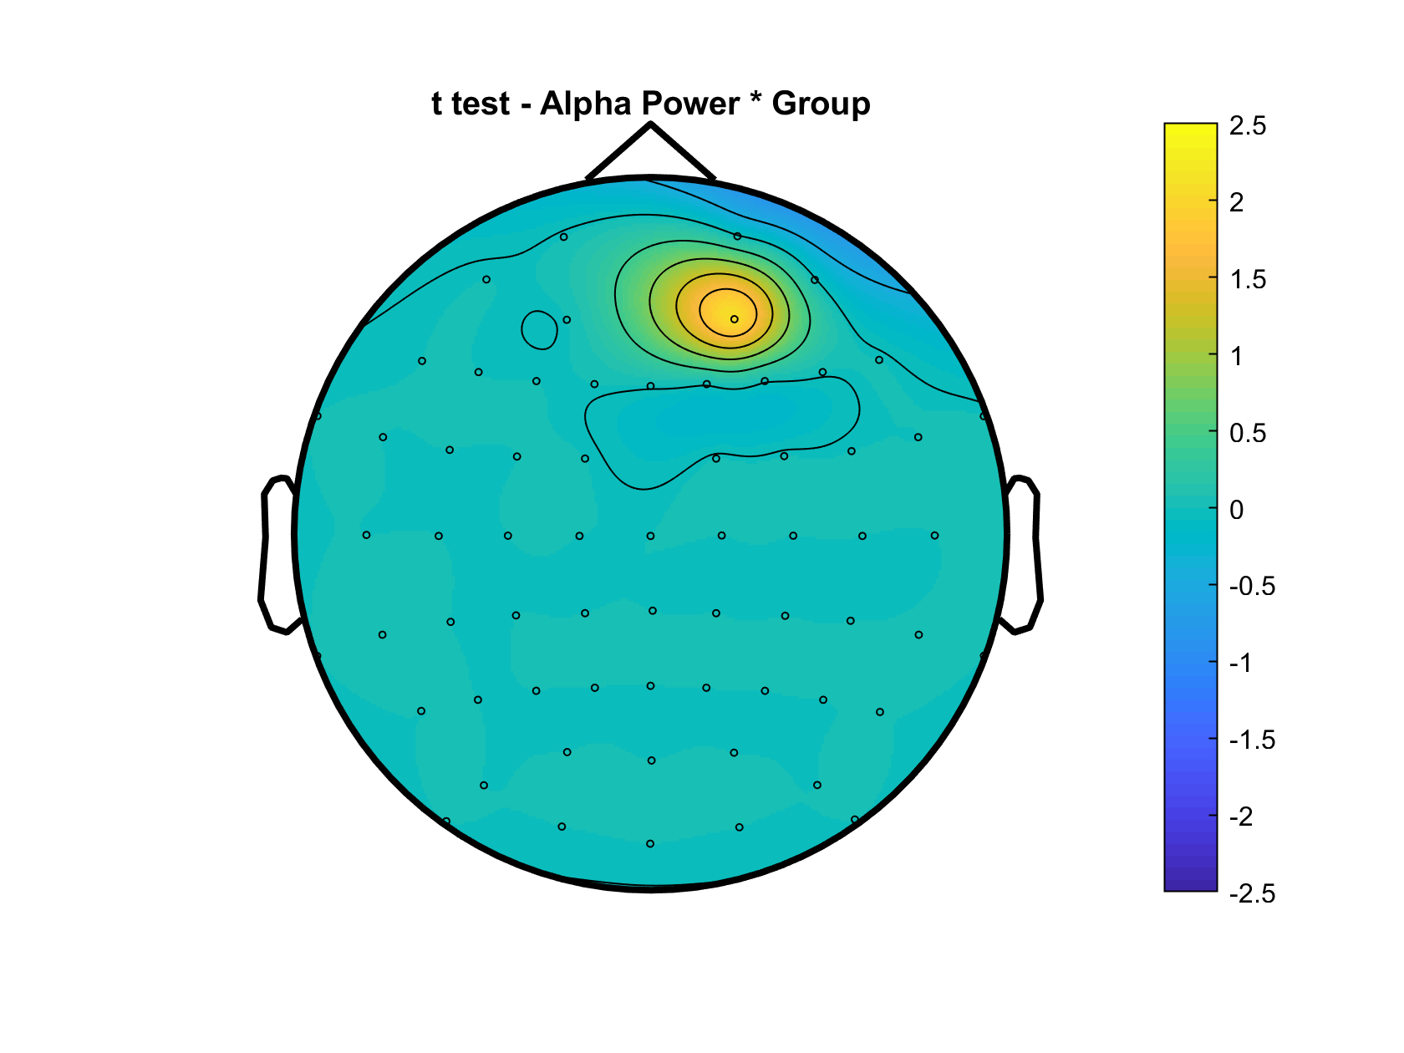
Group Oscillatory Differences

Slide 24
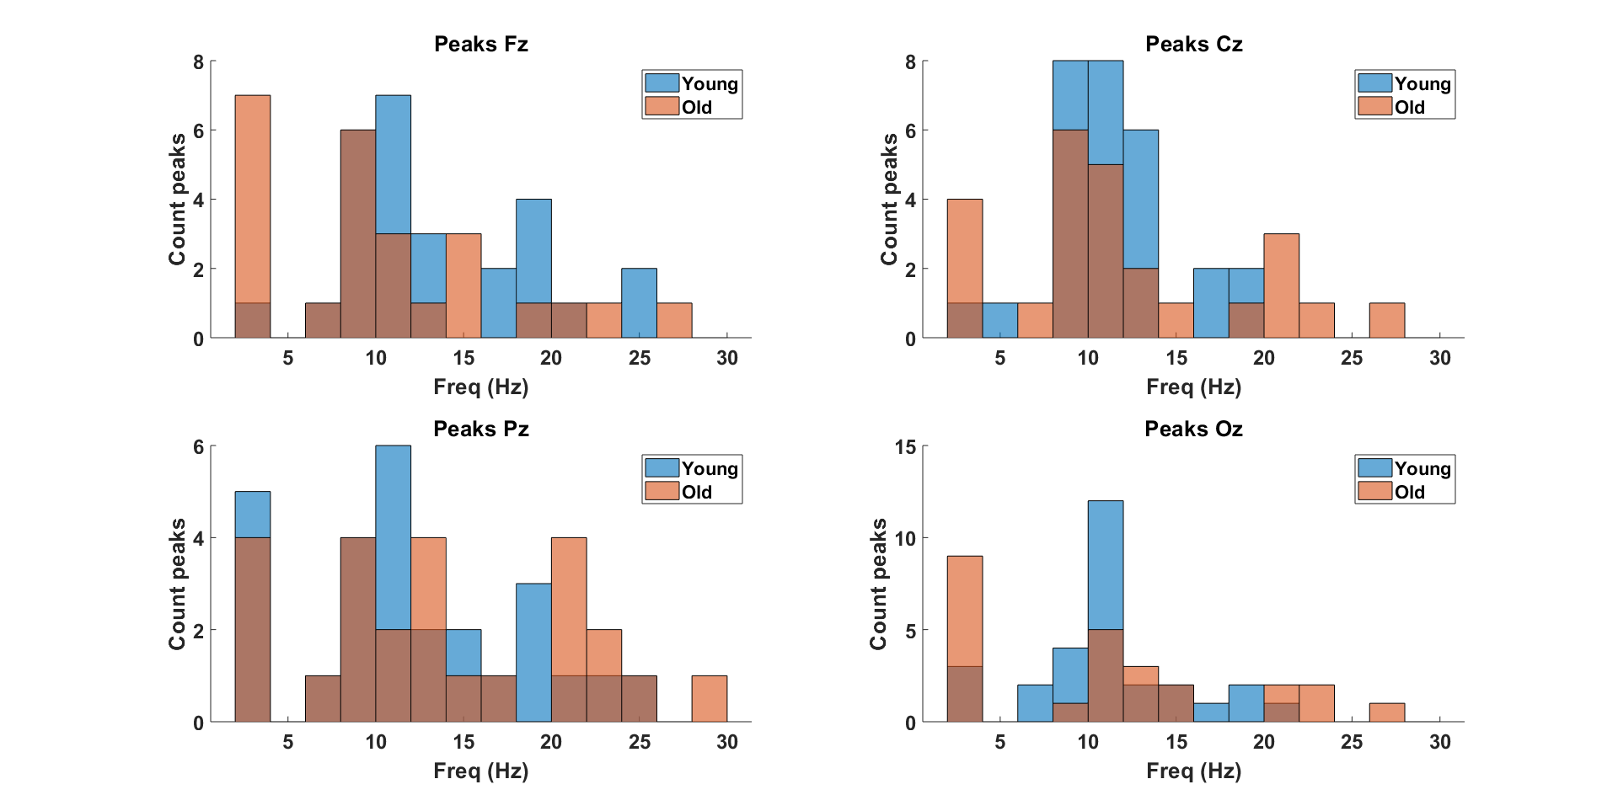
OLD SETTINGS

Slide 25
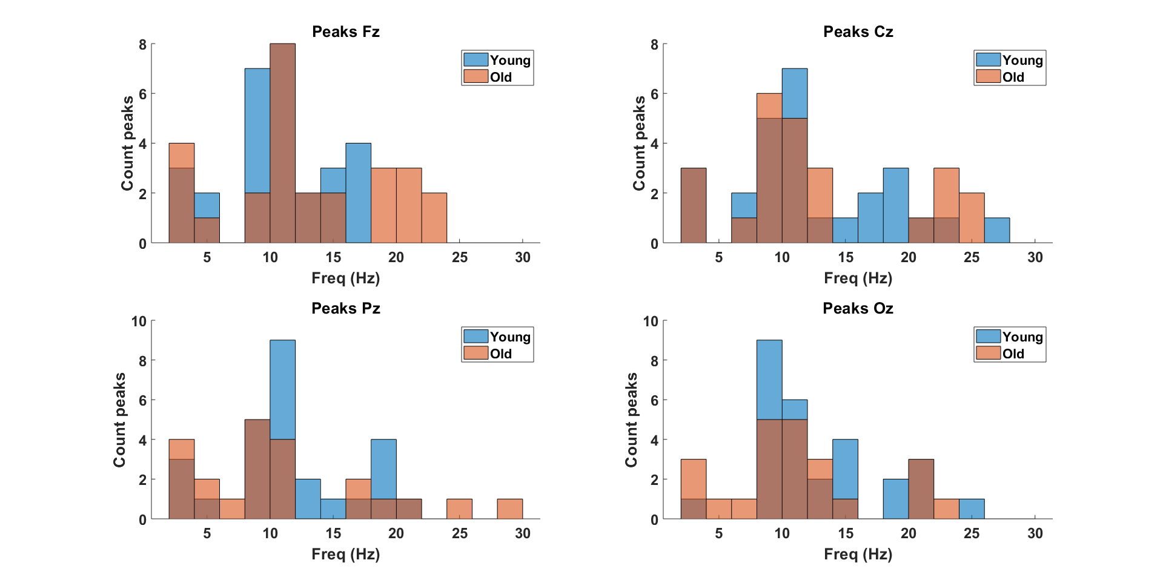
NEW SETTINGS

Slide 26
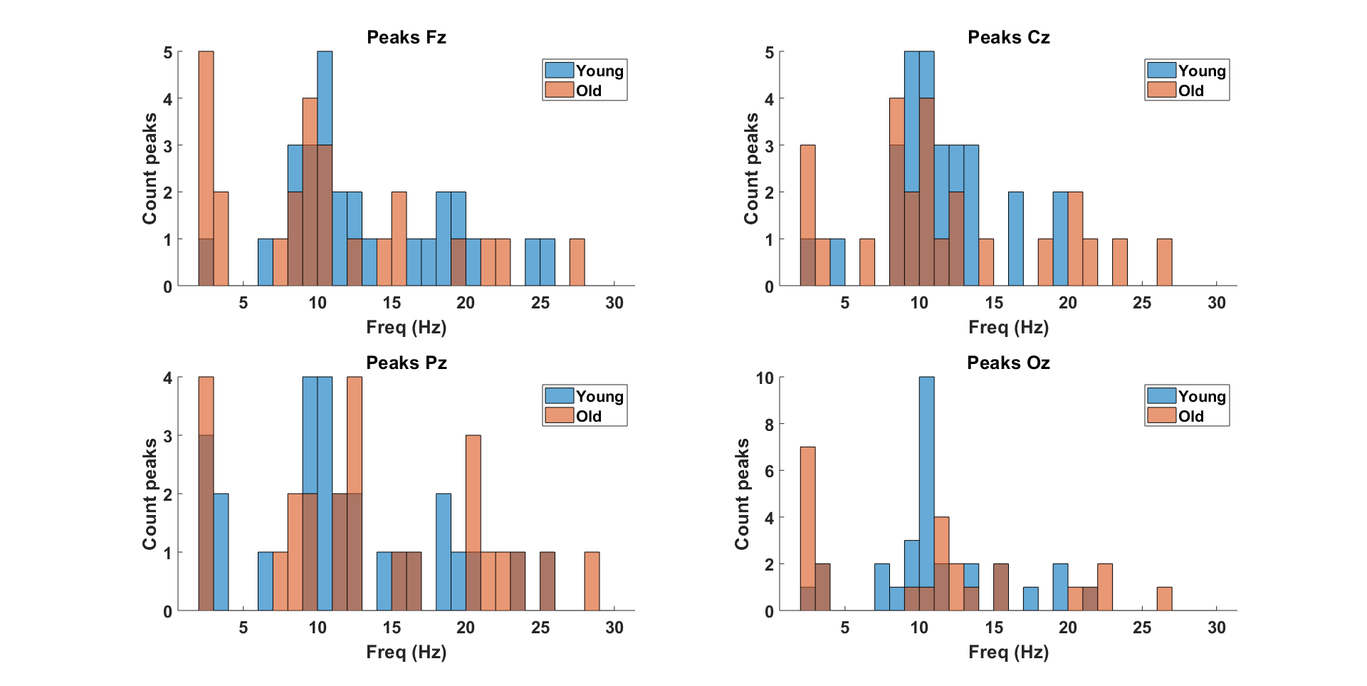
OLD SETTINGS
Notes:
Proportion of individuals with a peak in the alpha range and the theta/delta range (see all_detectedpeaks variable) – DONE (see slide 18)

Slide 27
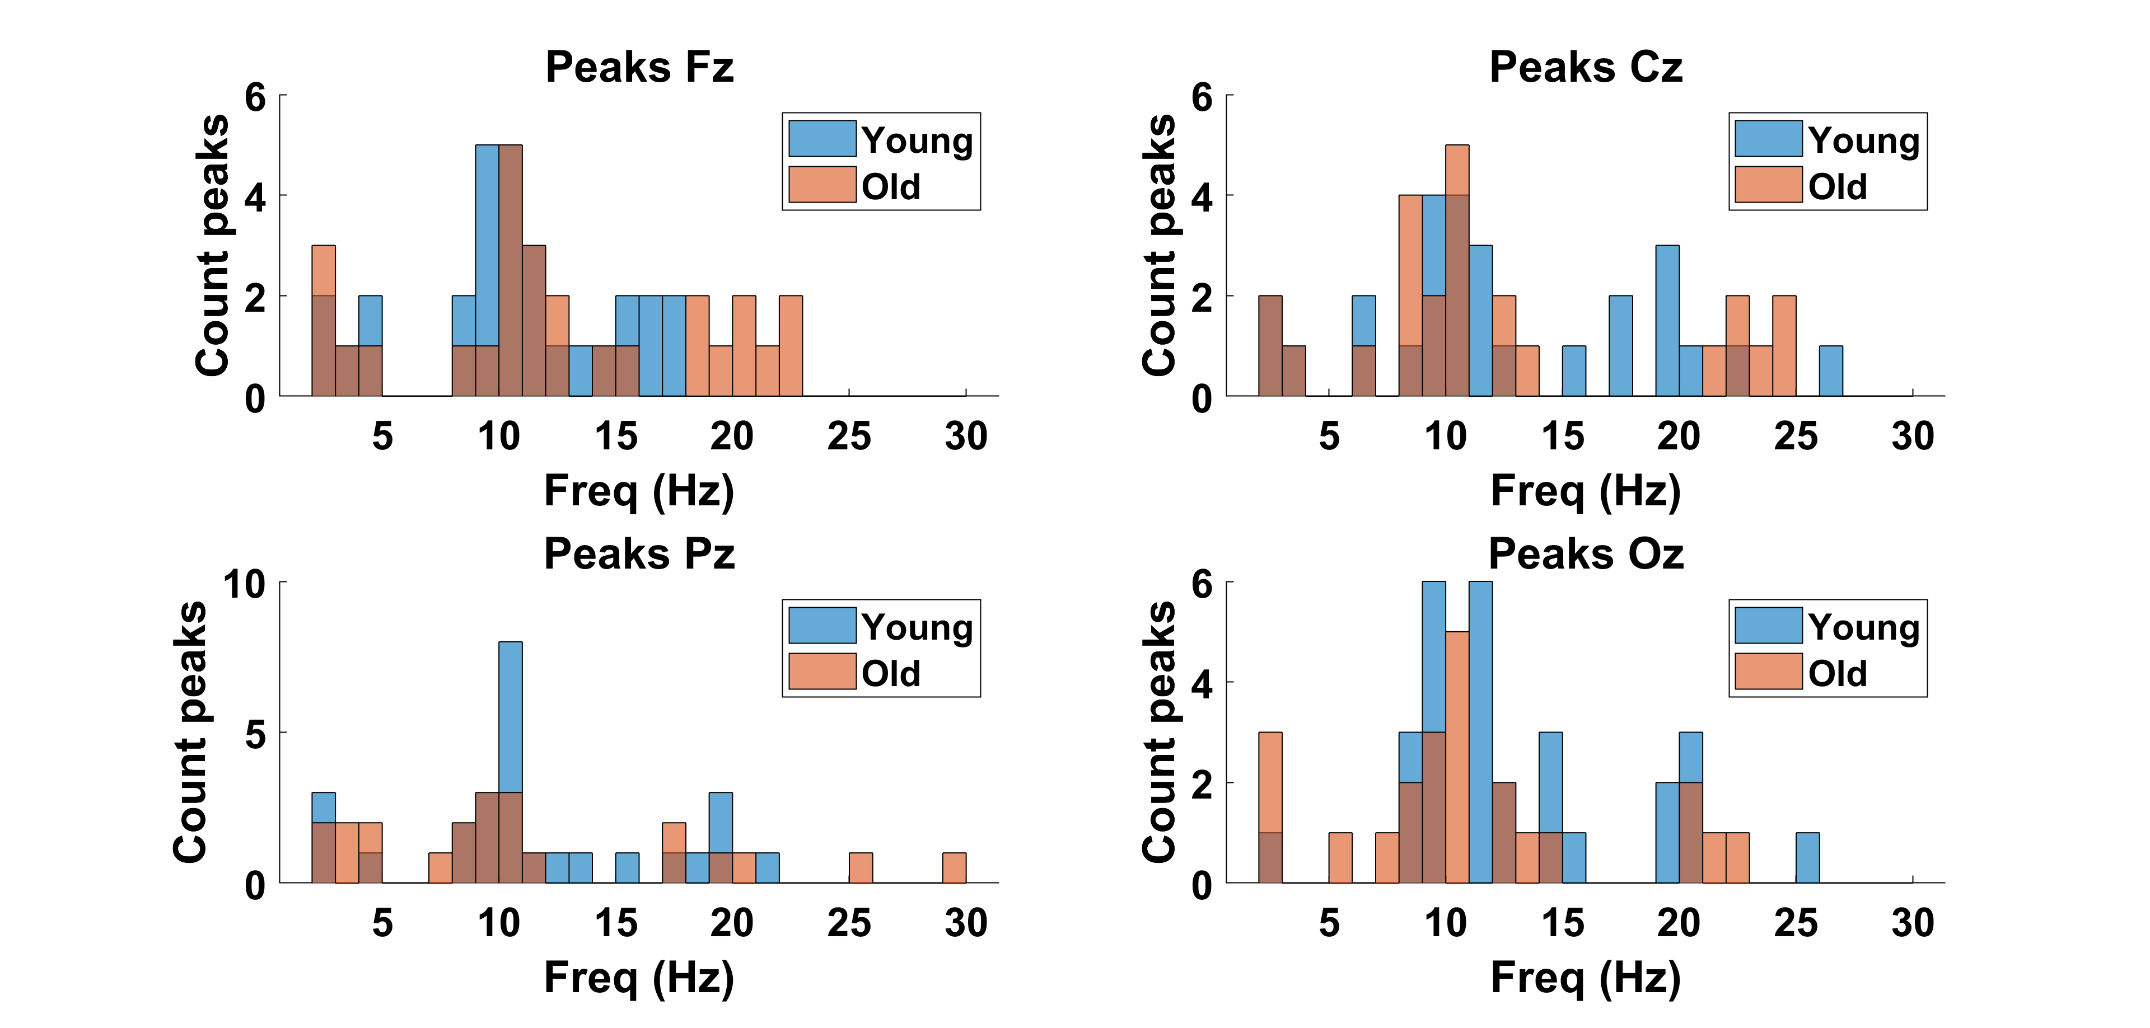
NEW SETTINGS

Slide 28
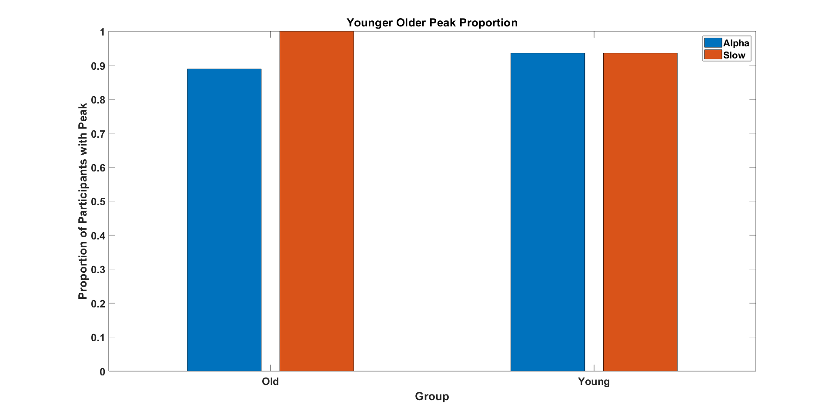

Slide 29
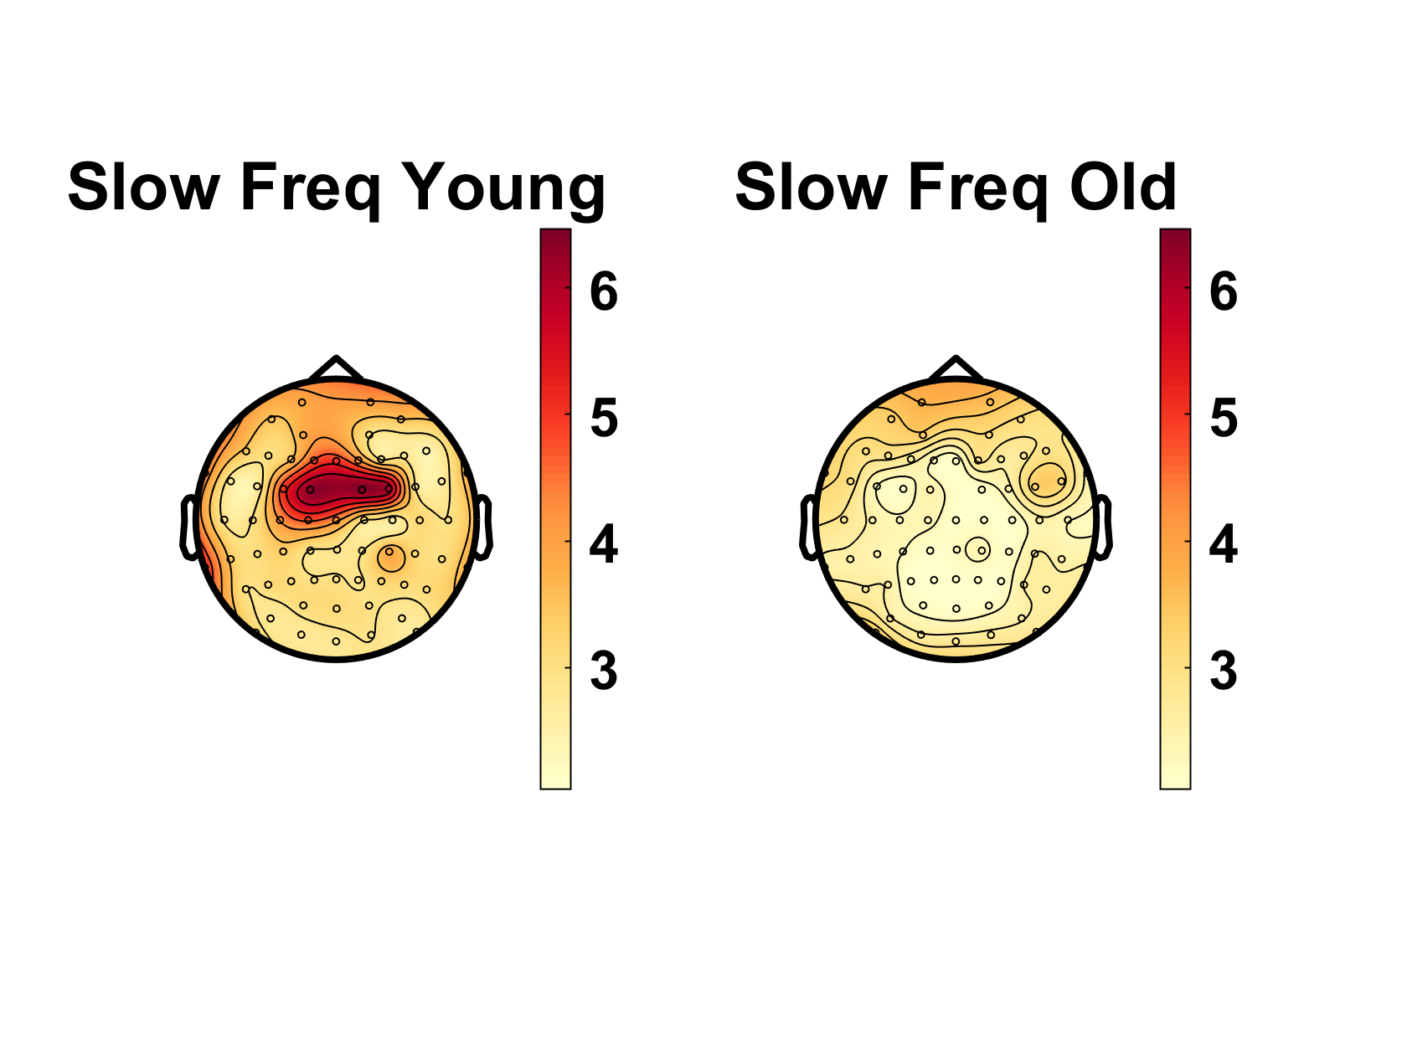
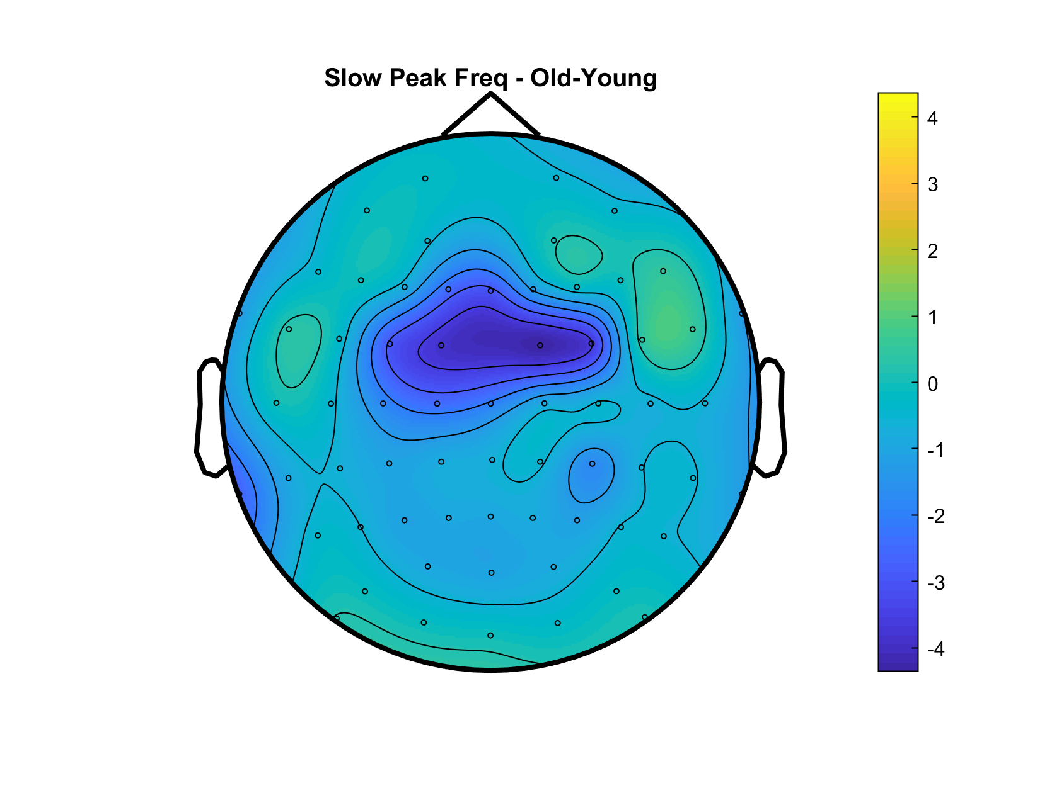
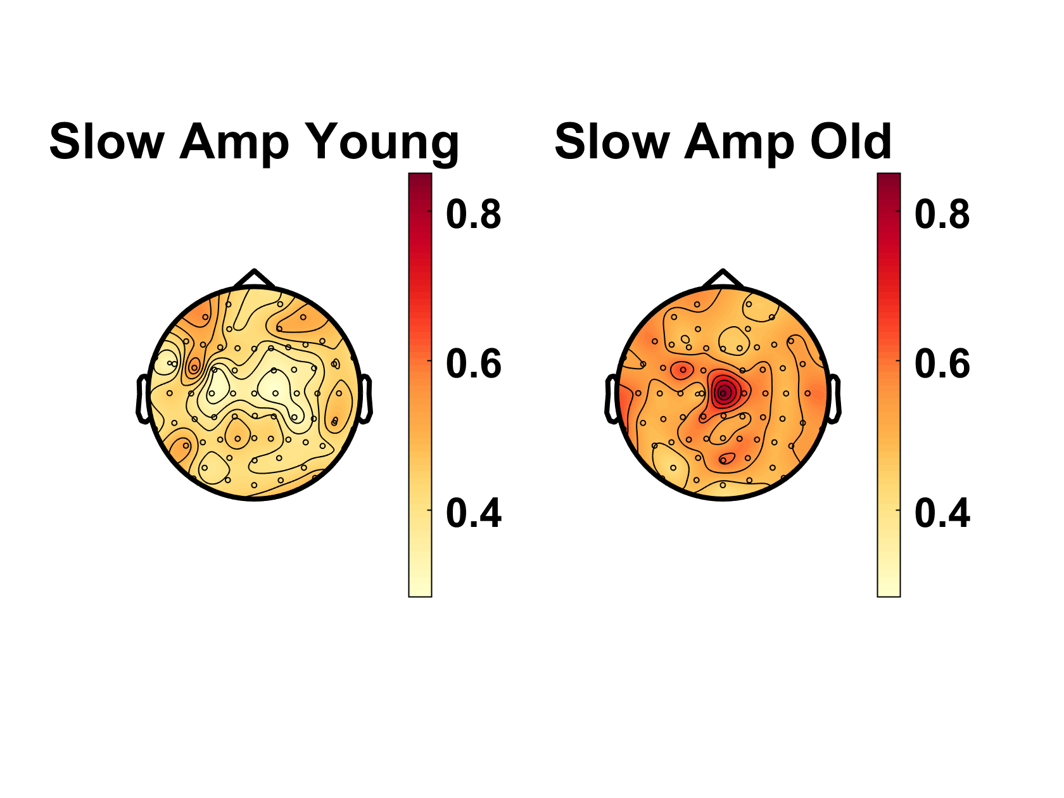

Slow Peak Frequency – Younger 90% vs Older 90%
Slow Peak Amplitude – Younger 90% vs Older 90%
Notes:
Same scale if possible – DONE
Pull delta & theta together - DONE

Slide 30




Delta Peak Frequency – Younger 90% vs Older 90%
Delta Peak Amplitude – Younger 90% vs Older 90%
Notes:
Same scale if possible

Slide 31


Delta Peak Frequency – Younger 90% vs Older 90%
OLD CUTOFFS
Delta Peak Amplitude – Younger 90% vs Older 90%

Slide 32




Theta Peak Frequency – Younger 90% vs Older 90%
Theta Peak Amplitude – Younger 90% vs Older 90%

Slide 33


Theta Peak Frequency – Younger 90% vs Older 90%
OLD CUTOFFS
Theta Peak Amplitude – Younger 90% vs Older 90%

Slide 34




Alpha Peak Frequency – Younger 90% vs Older 90%
Alpha Peak Amplitude – Younger 90% vs Older 90%

Slide 35


Alpha Peak Frequency – Younger 90% vs Older 90%
OLD CUTOFFS
Alpha Peak Amplitude – Younger 90% vs Older 90%

Slide 36




Beta Peak Frequency – Younger 90% vs Older 90%
Old-Young
Beta Peak Amplitude – Younger 90% vs Older 90%
Old-Young

Slide 37


Beta Peak Frequency – Younger 90% vs Older 90%
OLD CUTOFFS
Beta Peak Amplitude – Younger 90% vs Older 90%

Slide 38

Young 90% Coherence

Slide 39

Old 90% Coherence

Slide 40

Difference TF – Young-Old

Slide 41

Young 90% Coherence

Slide 42

Old 90% Coherence

Slide 43

Difference TF – Young-Old

Slide 44

Young 90% Coherence

Slide 45

Old 90% Coherence

Slide 46

Difference TF – Young-Old

Slide 47





Slide 48





Slide 49





Slide 50





Slide 51





Slide 52





Slide 53





Slide 54





Slide 55




Slide 56





Slide 57





Slide 58





Slide 59





Slide 60





Slide 61





Slide 62





Slide 63





Slide 64





Slide 65





Slide 66





